Slide 1
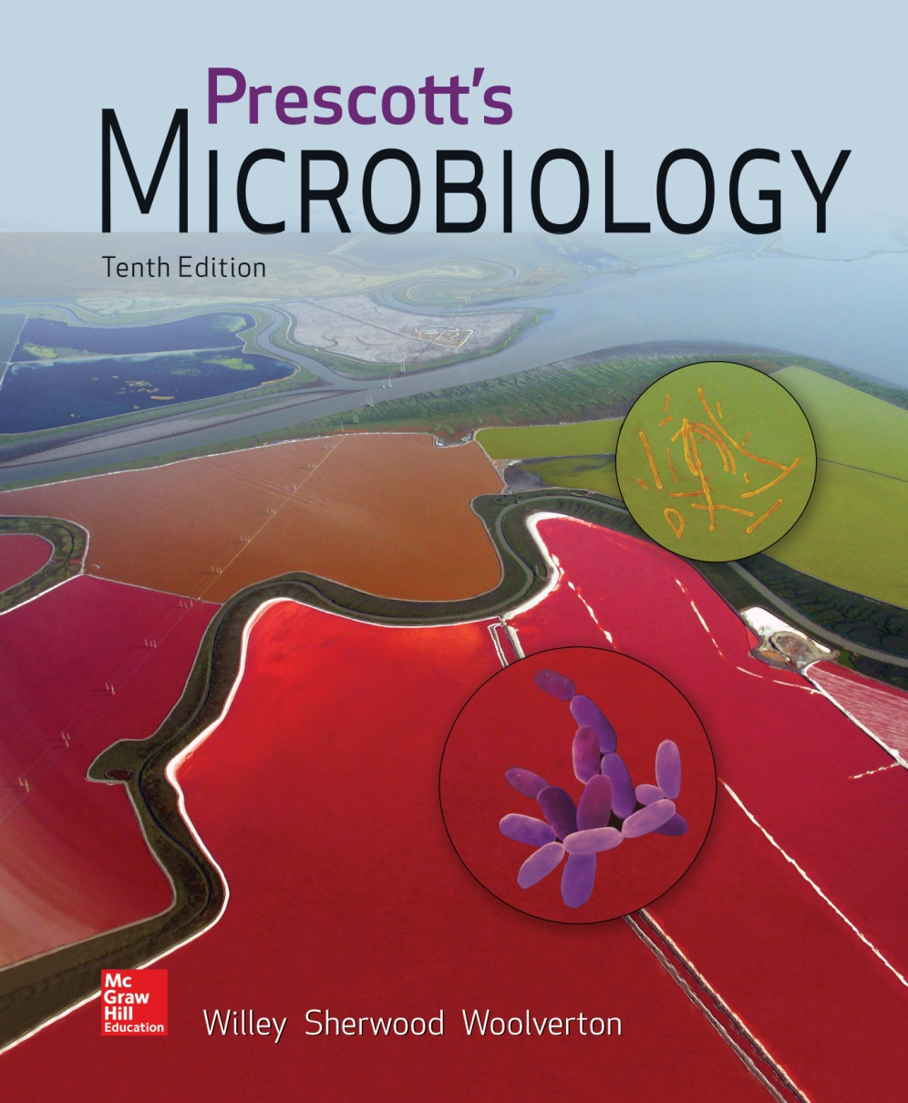
Chapter 22 – Proteobacteria

Slide 2
The Phylum Proteobacteria
The largest phylogenetically coherent bacterial group with more than 500 genera
Remarkable diverse morphologically, physiologically, and other ways
Volume 2 of Bergey’s Manual (2nd edition) is devoted to this group of bacteria

Slide 3
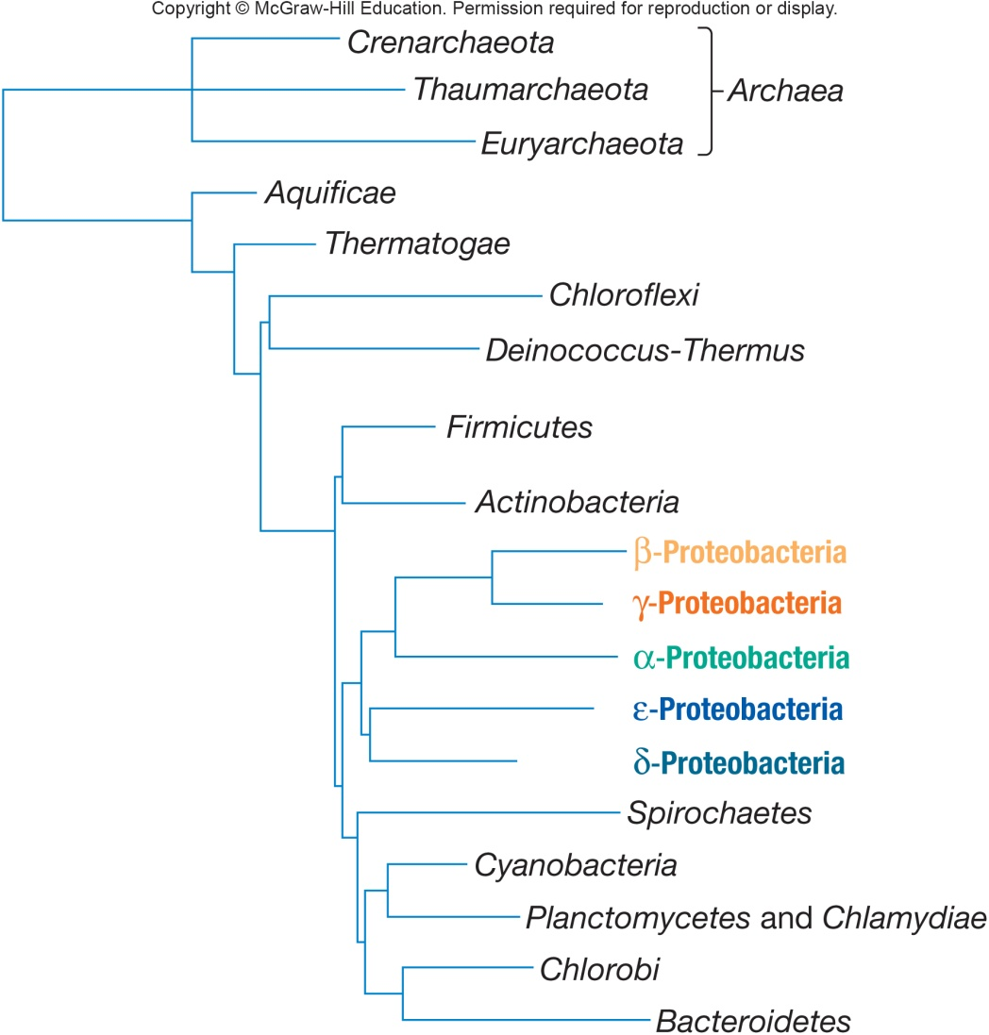
Lineages of Proteobacterium
Proteobacteria may have arose from a single photosynthetic ancestor
16S rRNA shows five distinct lineages
Alphaproteobacterium
Betaproteobacterium
Gammaproteobacterium
Deltaproteobacterium
Epsilonproteobacterium

Slide 4
22.1 Class Alphaproteobacteria Includes Many Oligotrophs
Describe the oligotrophic environments inhabited by some α-proteobacteria
Outline the metabolic flexibility of some purple photosynthetic bacteria
Draw the photosynthetic apparatus found in purple photosynthetic bacteria and label its constituent parts
List two unusual metabolic features of rickettsias and relate these to their intracellular lifestyle

Slide 5
22.1 Class Alphaproteobacteria Includes Many Oligotrophs - 2
Diagram the life cycles of Hyphomicrobium and Caulobacter spp.
Compare and contrast the relationship between Rhizobium and Agrobacterium spp. and plants
Identify the electron donors and the electron acceptor used in nitrification
List the physiological and taxonomic groups of microbes capable of nitrification

Slide 6
Class Alphaproteobacteria
Seven orders, 20 families
Rickettsiales may have been the earliest α-proteobacteria
Most of the oligotrophic bacteria
Most abundant bacteria in oceans
Evolved to live within plants and animals resulting in genome reduction or expansion
Metabolically diverse
methylotrophy, chemolithotrophs, nitrogen fixers

Slide 7
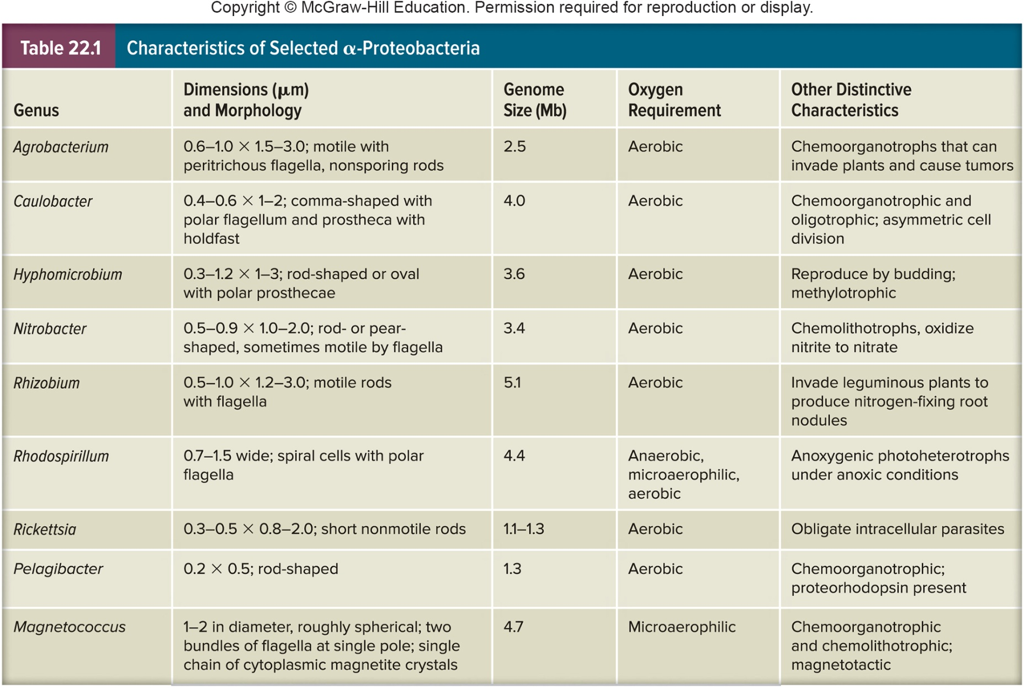
Characteristics of Select Alphaproteobacteria

Slide 8
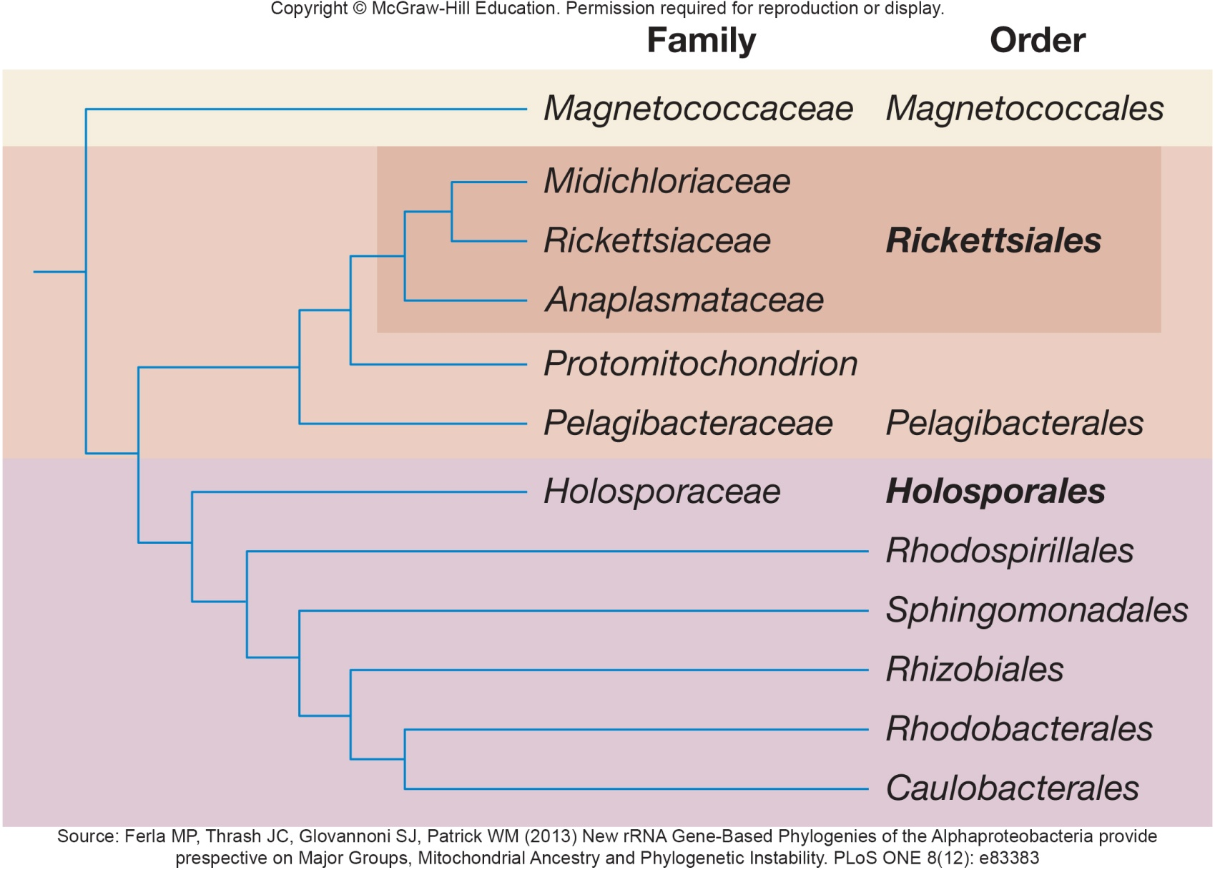
Proposed Subclasses of Alphaproteobacteria

Slide 9
Purple Nonsulfur Bacteria
With one exception (genus Rhodocyclus) all are α-proteobacteria
Metabolically flexible
normally grow anaerobically as anoxygenic photoorganoheterotrophs
possess bacteriochlorophylls a or b in photosystems located in membranes that are continuous with plasma membrane
some can oxidize sulfide, but not elemental sulfur, to sulfate

Slide 10
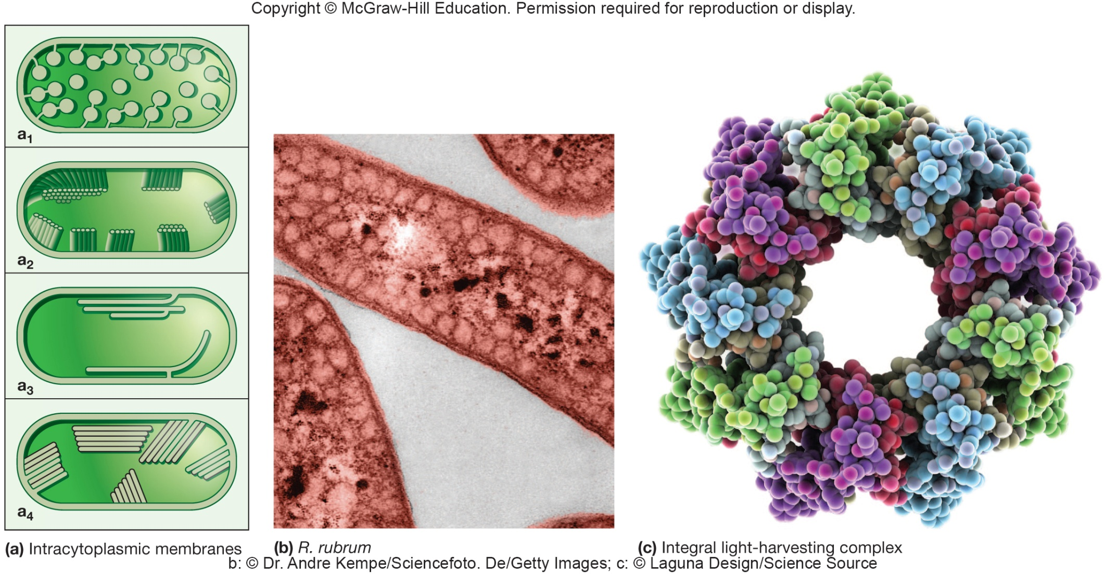
Photosynthetic Apparatus of Purple Bacteria

Slide 11
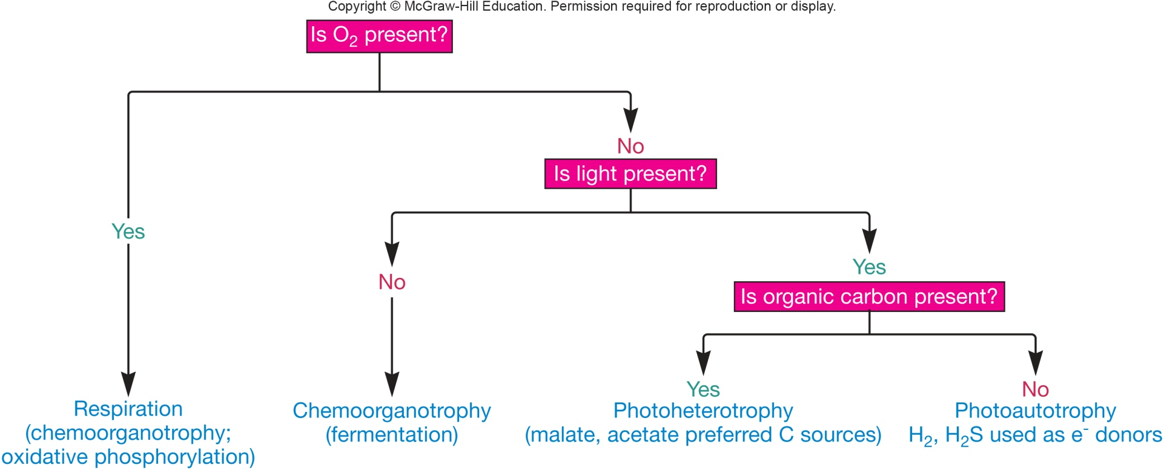
Purple Nonsulfur Bacteria – No Light?
In absence of light
most grow aerobically as chemoorganoheterotrophs
some carry out fermentation, photoheterotrophy, photoautotrophy, and grow anaerobically
Rhodosprillum best studied metabolic diversity

Slide 12
Purple Nonsulfur Bacteria – Industrial Uses
Rhodospirillum industrial importance
produces H₂
novel biodegradable plastic
oxidize carbon monoxide to carbon dioxide
Morphologically diverse
most motile by polar flagella
Found in mud and water of lakes and ponds with abundant organic matter and low sulfide levels; some marine species

Slide 13
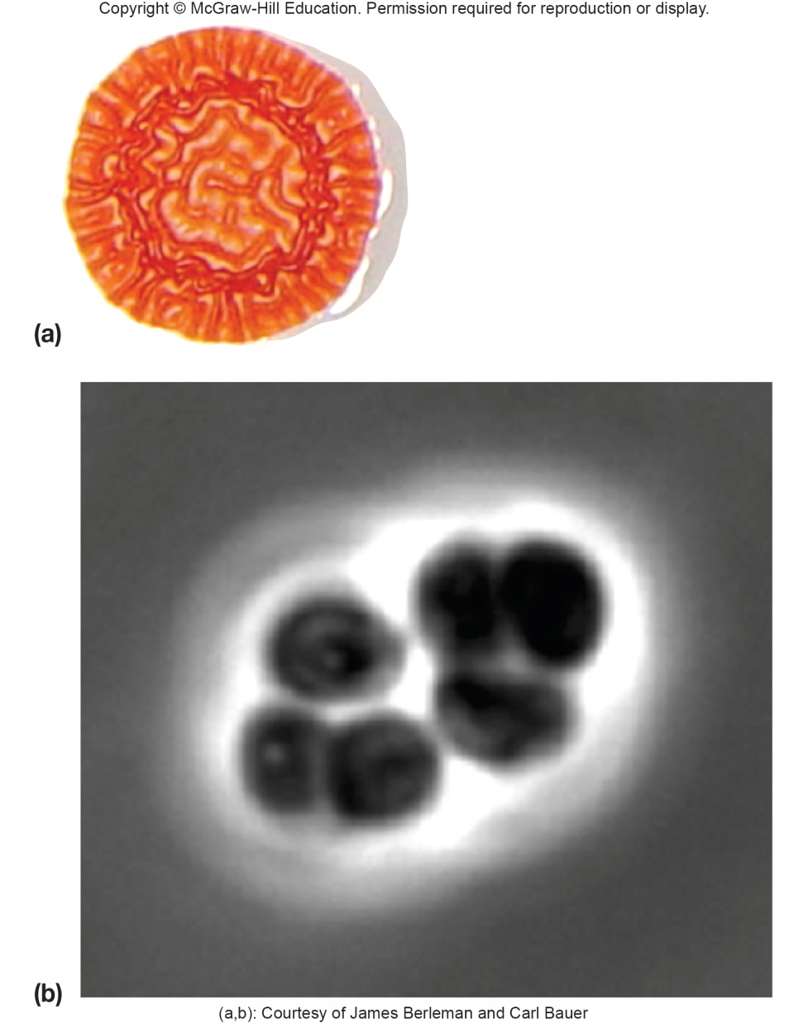
Purple Nonsulfur Bacteria - Cysts
Can produce cellular cysts
resting cells
resistant to desiccation but less tolerant of heat and UV than bacterial endospores
made in response to nutrient limitation
have thick outer coat and store polyhydroxybutyrate

Slide 14
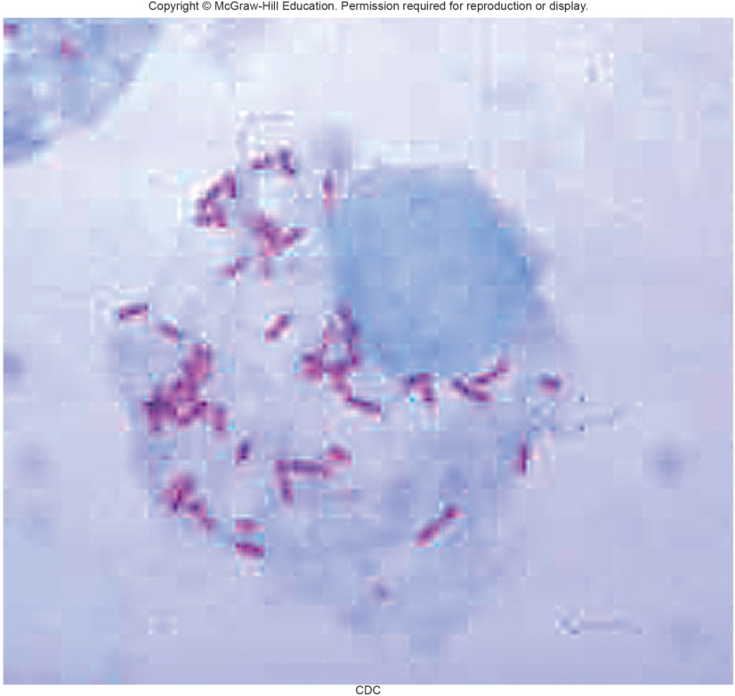
Rickettsia
Genus Rickettsia
order Rickettsiales;
family Rickettsiaceae
Very small, Gram-negative, non-flagellated, diverse morphology
All species are parasitic or mutualistic
grows in vertebrate erythrocytes, macrophages, vascular endothelial cells
live in blood sucking arthropods – vectors or primary hosts
Genome sequence similar to mitochondria
arose from endosymbiotic association
free living, aerobic bacterium became intracellular parasite of proto-eukaryotic cell that lacked organelles
gene reduction occurred and loss of free living ability

Slide 15
Rickettsia Metabolism and Pathogen Examples
Lack glycolytic pathway
do not use glucose as energy source
Oxidize glutamate and TCA cycle intermediates (e.g. succinate)
Take up and use ATP and other materials from host cell
Important pathogens
Rickettsia prowazekii and Rickettsia typhi – typhus fever
Rickettsia rickettsii – Rocky Mountain Spotted Fever
reproduction
enters host by phagocytosis
escapes phagosome
reproduces in cytoplasm
host cell bursts

Slide 16
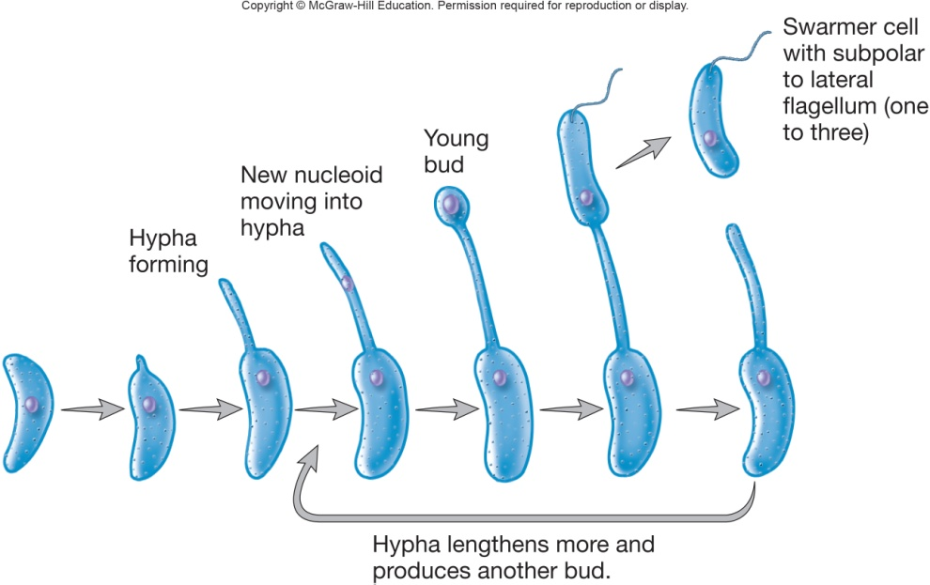
Caulobacteraceae and Hyphomicrobiaceae
Rods or cocci with an appendage
Life cycle
prostheca (pl., prosthecae) or stalk
extension of cell, including plasma membrane, that is narrower than mature cell
reproduction by budding
progeny cell is a bud that first appears as a small protrusion on parent cell and enlarges to form mature cell

Slide 17
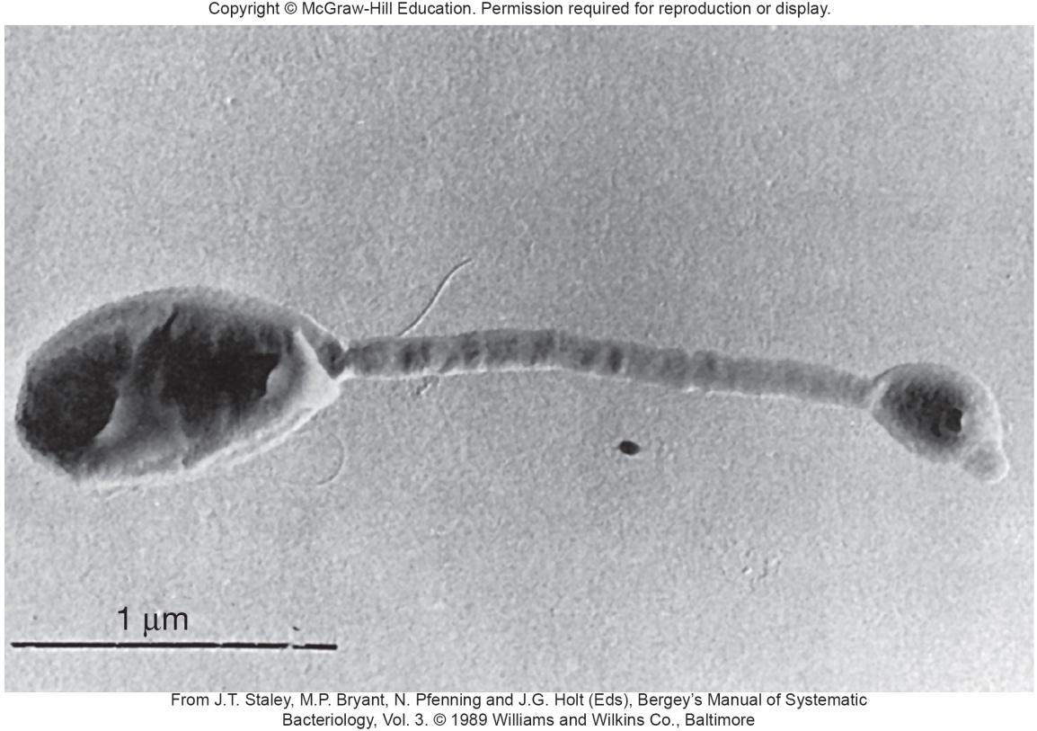
Genus Hyphomicrobium
Prosthecate, budding bacteria
Aerobic chemoheterotrophs
grow on ethanol, acetate, and one-carbon molecules (facultative methylotroph)
e.g., methanol, formate, and formaldehyde
Frequently attach to solid objects in aquatic and terrestrial environments
may be 25% of total bacterial
population in oligotrophic
(nutrient-poor) freshwater
habitats

Slide 18
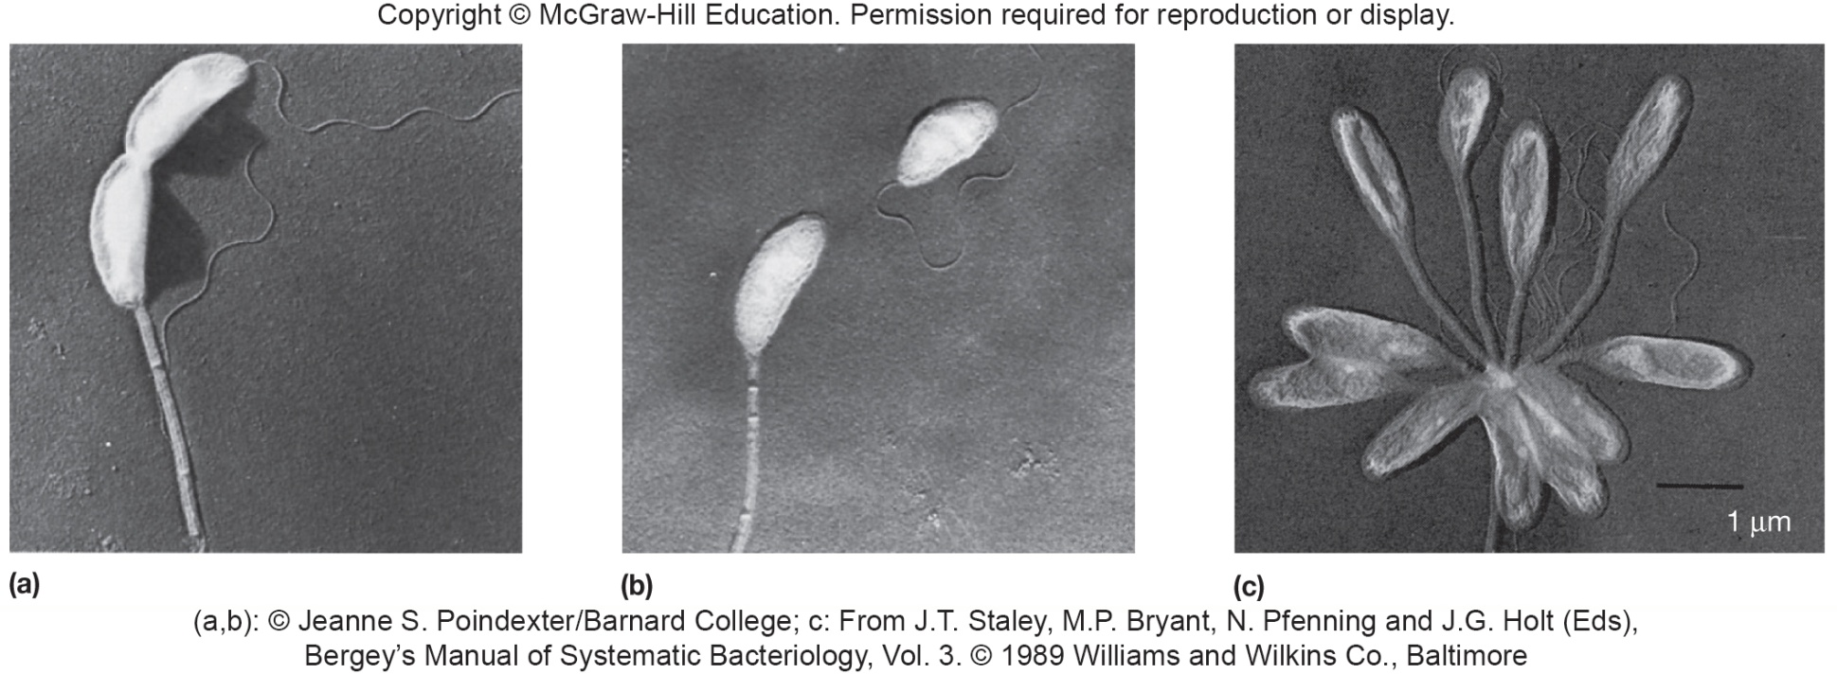
Genus Caulobacter
May be polarly flagellated rods or may possess prostheca and holdfast
used to attach to solid substrata with what is known as the strongest biological adhesion molecule
prostheca lacks cytoplasmic components

Slide 19
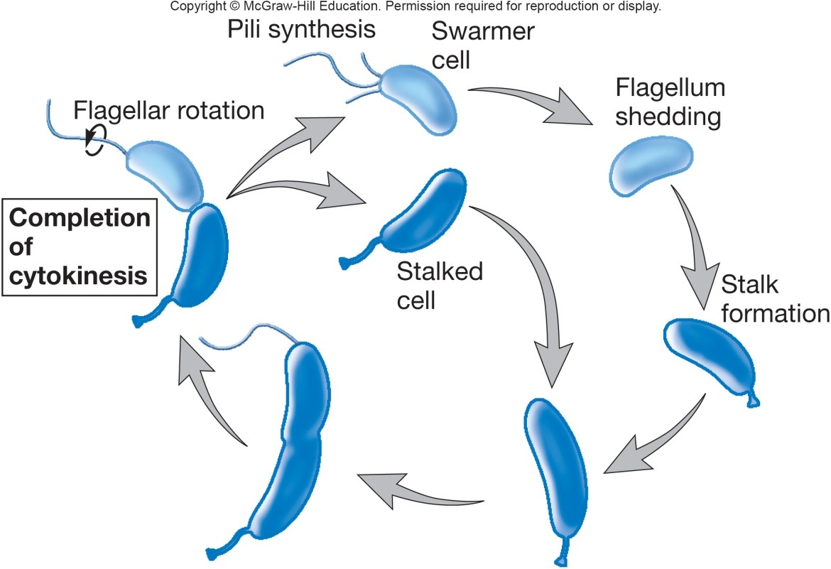
Genus Caulobacter – Lifecycle
Usually found in oligotrophic aquatic and terrestrial habitats
may absorb nutrients released from hosts
long prosthecae may improve nutrient uptake
Reproduction
asymmetric transverse binary fission

Slide 20
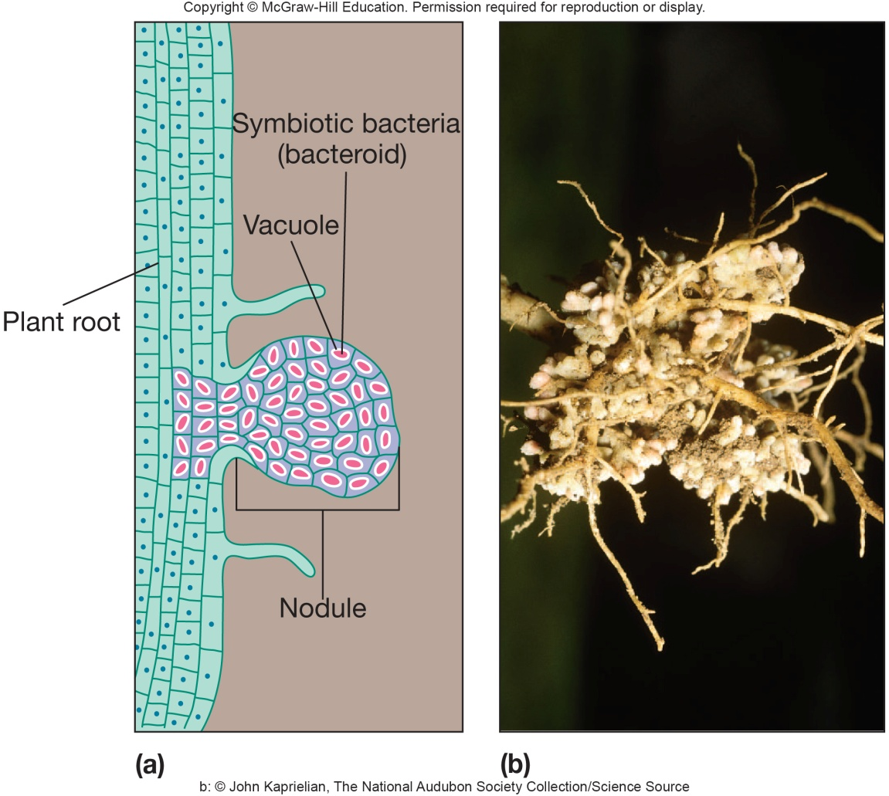
Genus Rhizobium
Gram-negative, pleomorphic, motile rods
often contain poly-β-hydroxybutyrate granules
Grow symbiotically as nitrogen-fixing bacteroids within root nodule cells of legumes
most successful plant family on earth

Slide 21
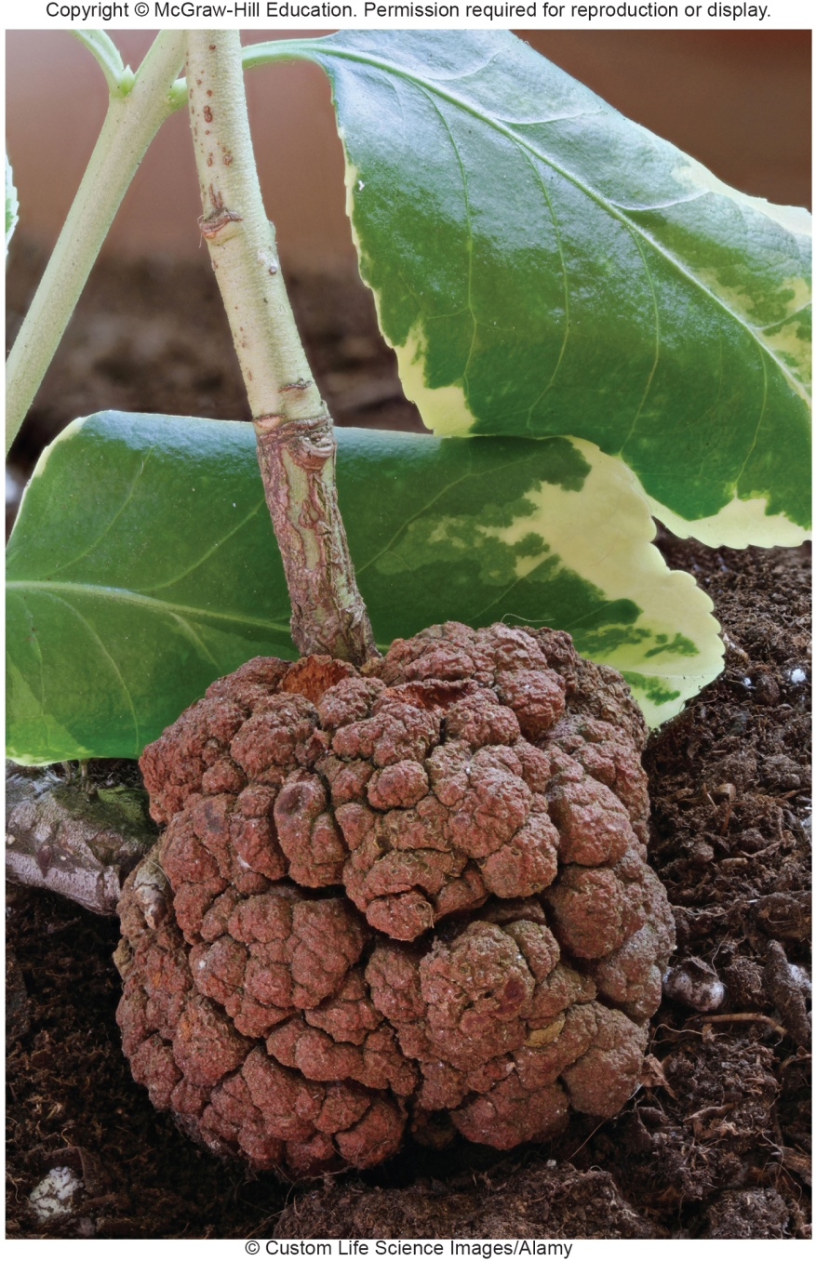
Genus Agrobacterium
Do not stimulate nodule formation or fix nitrogen
Invade crown, roots, and stems of many plants
transform infected plant cells into autonomously proliferating tumors
e.g. Agrobacterium tumefaciens
causes crown gall disease by means of tumor-inducing (Ti) plasmid

Slide 22
Genus Brucella
Important human and animal pathogen
undulant fever – zoonosis
Tiny, faintly staining coccobacilli

Slide 23
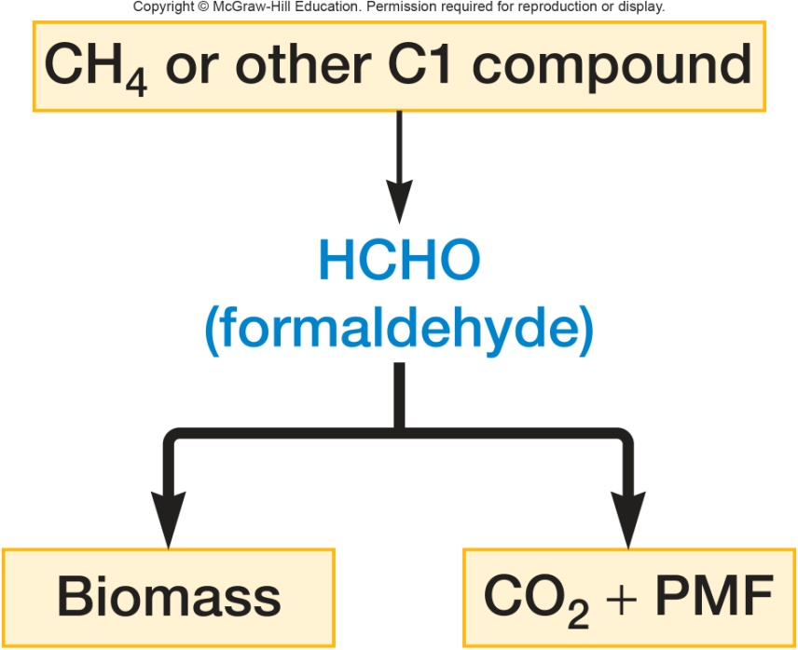
Genera Methylocystis and Methylosinus - Metabolism
Growth supported by assimilation of C1 compounds (methanol, methylamine)
used as both carbon AND energy source
first step is oxidation to formaldehyde
second step is either incorporation (biomass) or further oxidation (energy)
Possess extensive intracellular membranes
Often form a resting cell called exospore
Energy; proton motive force

Slide 24
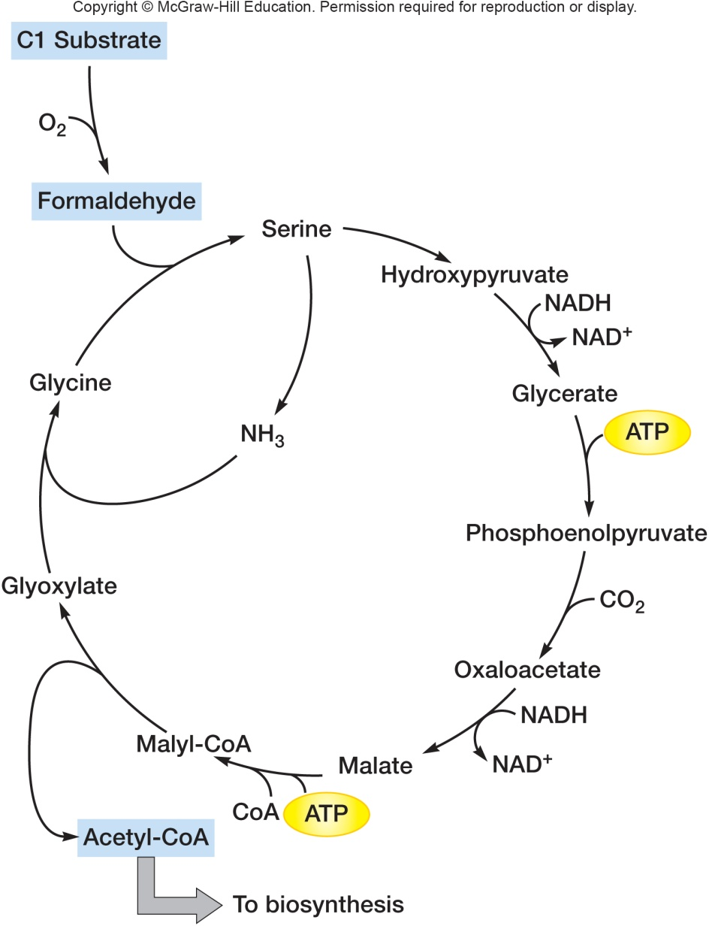
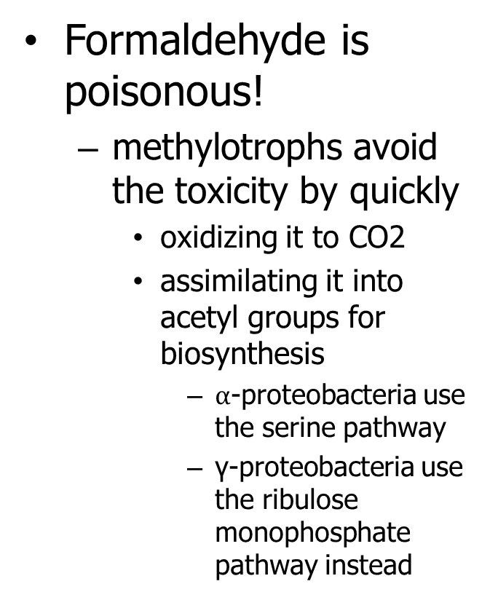
Genera Methylocystis and Methylosinus
Formaldehyde is poisonous!
methylotrophs avoid the toxicity by quickly
oxidizing it to CO2
assimilating it into acetyl groups for biosynthesis
$α$-proteobacteria use the serine pathway
γ-proteobacteria use the ribulose monophosphate pathway instead

Slide 25
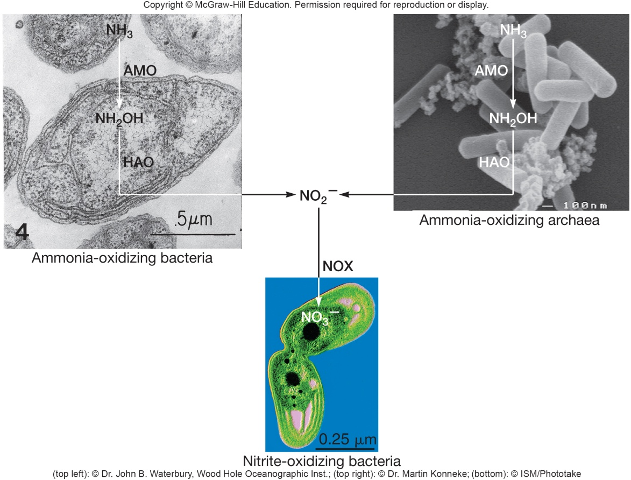
Nitrifying Bacteria
Very diverse chemolithoautotrophs
nitrification – gain electrons from oxidation of
ammonium to nitrate or nitrite
nitrite further oxidized to nitrate

Slide 26
Nitrification
Ammonia → nitrite → nitrate
Conversion of ammonia to nitrate by action of two genera
e.g. Nitrosomonas – ammonia to nitrite
e.g. Nitrobacter – nitrite to nitrate
Fate of nitrate
easily used by plants
lost from soil through leaching or denitrification

Slide 27
Taxa of Nitrifying Bacteria
Divided into several taxa
class Alphaproteobacteria
e.g. genus Nitrobacter
class Betaproteobacteria
e.g. genera Nitrosomonas and Nitrosospira
class Gammaproteobacteria
family Ectothiorhodospiraceae
e.g. genus Nitrococcus
family Chromatiaceae
e.g. genus Nitrosococcus

Slide 28
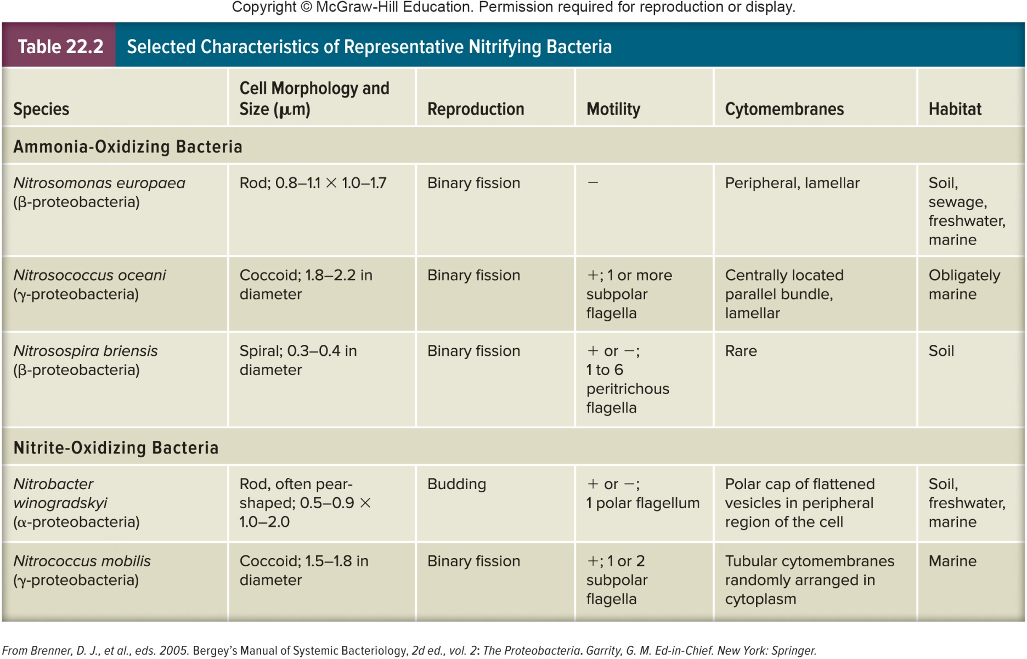
Characteristics of Nitrifying Bacteria

Slide 29
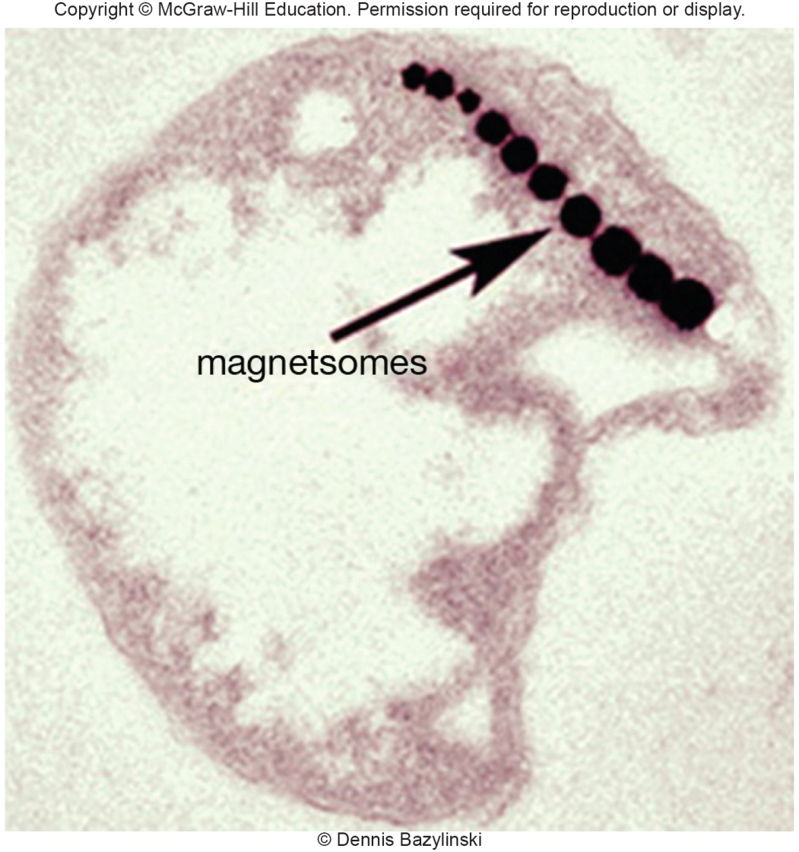
Magnetococcus: A Newly Discovered Genus
M. marinus
only spherical magnetotactic bacterium in pure culture
two sheathed bundles of flagella at one pole (bilophotrichous)
magnetotaxis mediated by single row of magnetite crystals arranged in cytoplasm
isolated from oxic/anoxic interface of estuary
obligately microaerophilic
can grow chemoorganoheterotrophically or chemolithoautotrophically

Slide 30
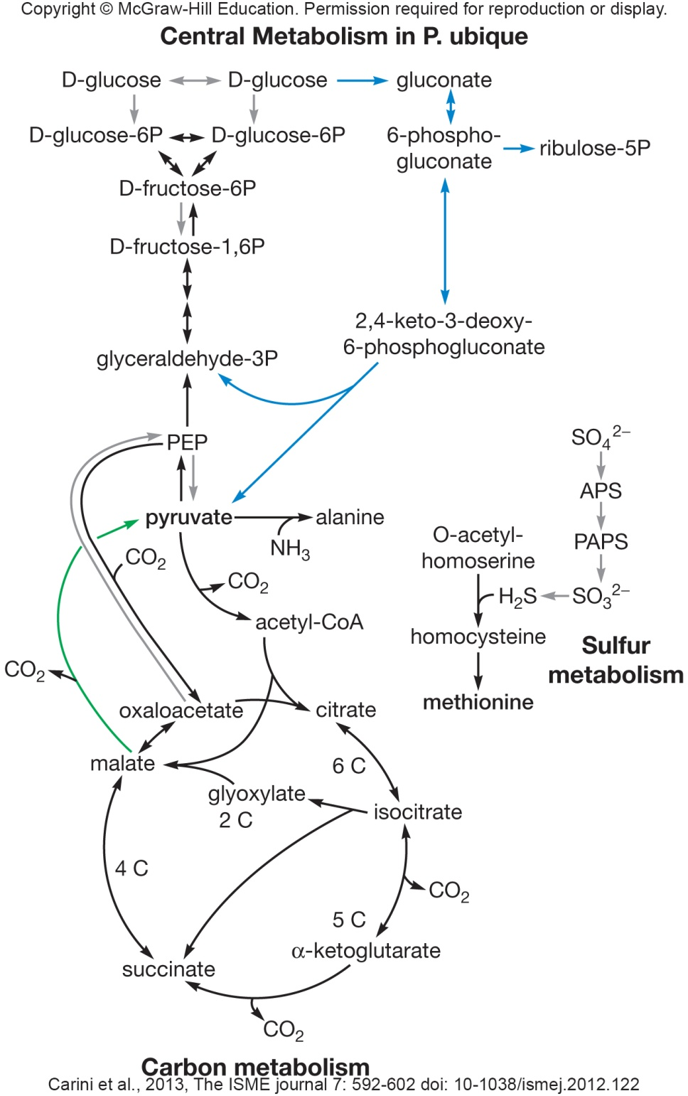
SAR11 Clade
Sargasso Sea clade is the most abundant group of microbes on Earth
All members are chemoorganoheterotrophs
Appear to reverse Embden-Myerhof pathway for gluconeogenesis; modified Entner-Duodoroff pathway for glucose oxidation
Candidatatus Pelagibacter ubique is sole cultured representative of group
1.31 Mb genome; optimized for life with scant nutrients

Slide 31
22.2 Class Betaproteobacteria Includes Chemoheterotrophs and Chemolithotrophs
List human diseases caused by Neisseria and Bordatella spp.
Discuss the function of the sheath in the physiology of Leptothrix spp.
Summarize the reactions used by Nitrosomonas europaea to oxidize ammonium to nitrite
Differentiate between nitrification and denitrification, and identify the electron donors and acceptors for each
Explain how sulfur-oxidizing bacteria obtain ATP from reduced sulfur species via substrate-level phosphorylation

Slide 32
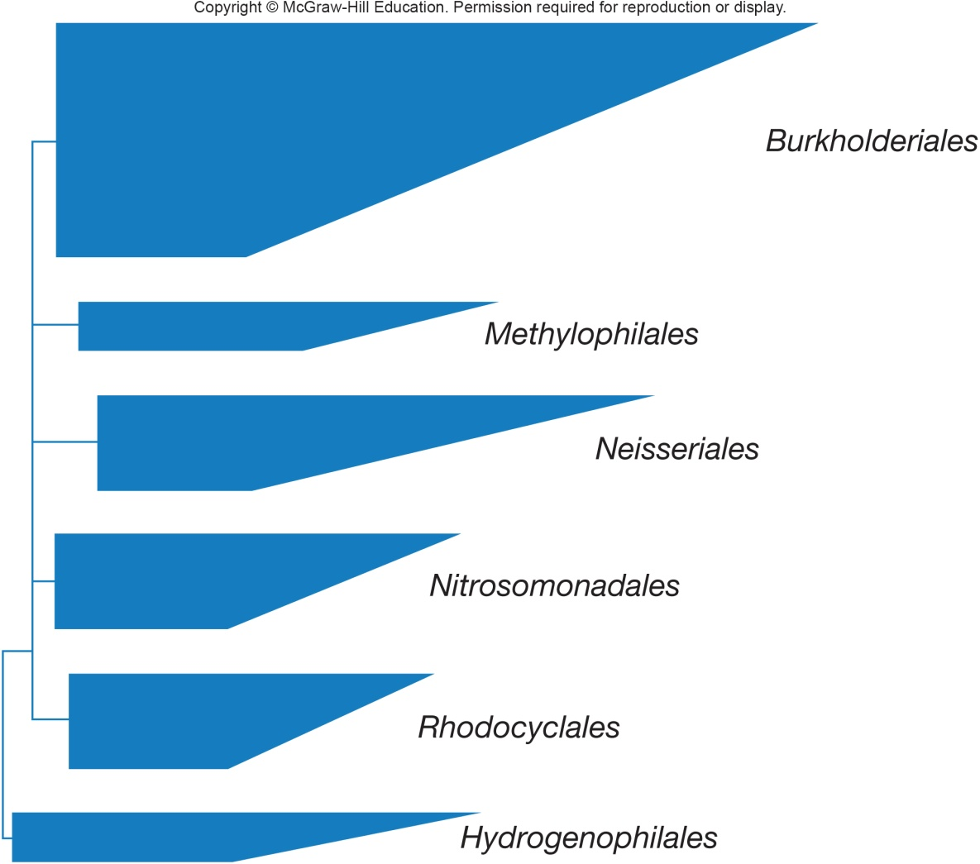
Class Betaproteobacteria
Seven orders, 12 families
Considerable metabolic diversity
overlap α-proteobacteria metabolically but generally use decomposed organic matter anoxically
some use hydrogen, methane, ammonia, volatile fatty acids

Slide 33
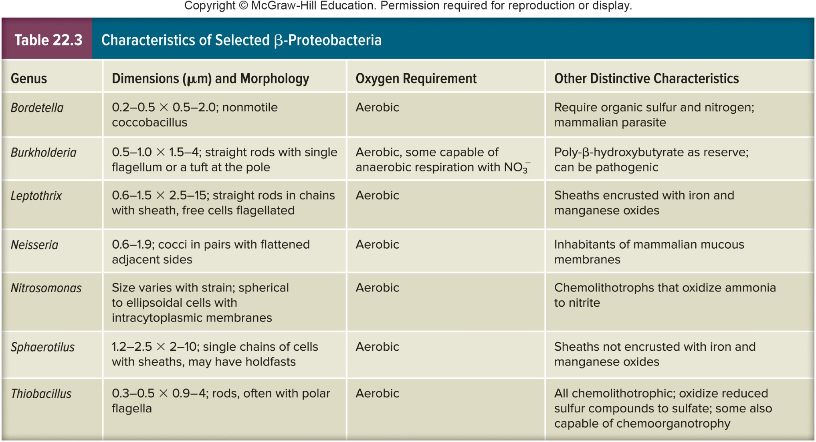
Characteristics of Select Betaproteobacteria

Slide 34
Order Neisseriales
Genus Neisseria
nonmotile, Gram-negative cocci
most often occur in pairs with adjacent sides flattened
may have capsules and fimbriae
aerobic chemoorganotrophs
oxidase positive and usually catalase positive
may have capsules and fimbriae
inhabitants of mucous membranes of mammals
some human pathogens
Neisseria gonorrhoeae – gonorrhea
Neisseria meningitidis – meningitis

Slide 35
Order Burkholderiales
Well-known genera
Burkholderia, Bordetella, Sphaerotilus, and Leptothrix
Some members have a sheath
hollow tubelike structure surrounding chain of cells
may contain ferric or manganic oxides
functions
attachment to surfaces
obtaining nutrients from slowly running water
protection against predators

Slide 36
Genus Burkholderia
Gram-negative, non–spore-forming, straight rods
most motile with single flagellum or tuft of polar flagella
Aerobic and mesophilic
Nonfermentative chemoorganotrophs
catalase positive; often oxidase positive
most use poly-β-hydroxybutyrate as carbon reserve
e.g. Burkholderia cepacia
degrades >100 organic molecules
very active in recycling organic material
plant pathogen
has become a major nosocomial pathogen
particular problem for cystic fibrosis patients

Slide 37
Nitrogen Fixation by Burkholderia and Ralstonia
Form symbiotic associations with legumes similar to that formed by rhizobia
Have nodulation genes (nod) similar to rhizobia suggesting a common genetic origin
genetic information may have been obtained through lateral gene transfer

Slide 38
Genus Bordetella
Gram-negative coccobacilli
some have capsules
Aerobic chemoorganotrophs
respiratory metabolism
require organic sulfur and amino acids for growth
Mammalian parasites that multiply in respiratory epithelial cells
nonmotile, encapsulated species
whooping cough and kennel cough

Slide 39
Order Nitrosomonadales
Number of chemolithotrophs
e.g. two genera of nitrifying bacteria
Nitrosomonas and Nitrosospira
oxidize ammonia to nitrite
enzyme ammonia monooxygenase (AMO)
enzyme hydroxylamine oxidoreductase
also auxotrophic AUTOTROPHIC metabolism
fixes CO₂ in Calvin cycle

Slide 40
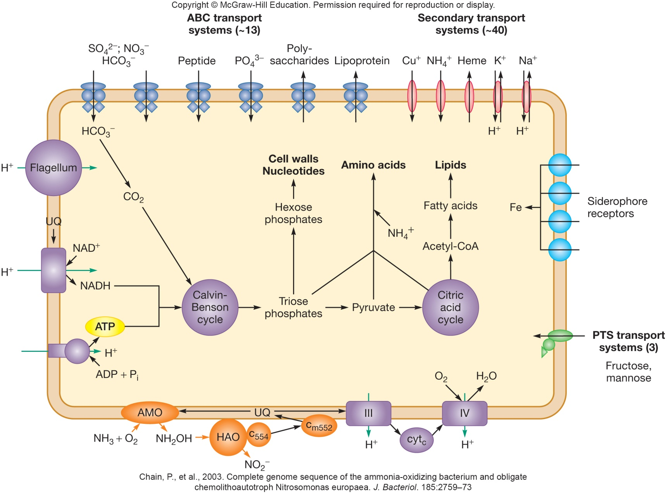
Genomic Reconstruction of N. europaea

Slide 41
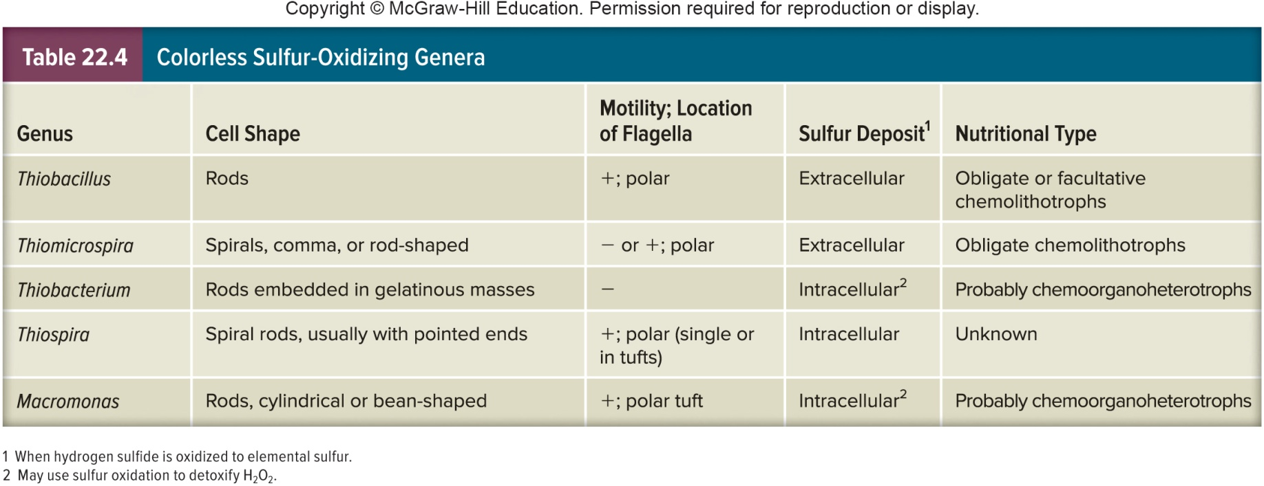
Order Hydrogenophilales
Contains genus Thiobacillus
Well-studied chemolithotroph
prominent member of colorless sulfur bacteria
chemolithotrophs that oxidize sulfur compounds
other colorless sulfur bacteria are in class Gamma proteobacteria

Slide 42
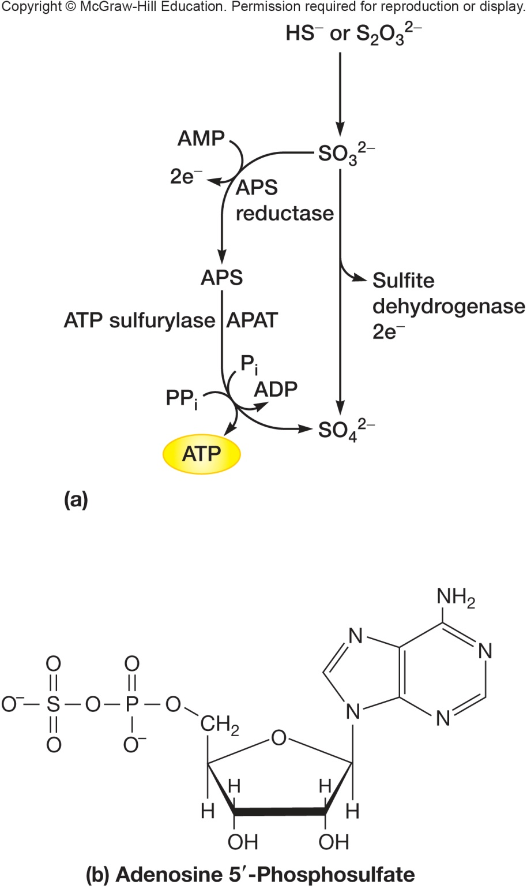
Genus Thiobacillus
Found in soil and aquatic habitats
production of sulfuric acid can cause corrosion of concrete and metal structures
may increase soil fertility by releasing sulfate
used in leaching metals from low grade metal ores

Slide 43
22.3 Class Gammaproteobacteria Is The Largest Bacterial Class
Relate the electron donors used by a variety of γ-proteobacteria to the habitats in which they thrive
Describe the multicellular arrangements and unusual cellular morphologies displayed by some γ-proteobacteria
Outline the oxidation of methane by methanotrophs
Compare the intracellular life cycle of Legionella spp. to that of Coxiella spp.
Describe four practical aspects of pseudomonads

Slide 44
22.3 Class Gammaproteobacteria Is The Largest Bacterial Class – 2
List at least five electron acceptors used by Shewanella and explain the term dissimilatory metal reduction
Describe three strategies used by dissimilatory metal-reducing bacteria that enable their use of insoluble compounds as electron acceptors
Compare and contrast the physiology and importance of members of Vibrionales with those in Enterobacteriales and Pasteurellales
Summarize mixed acid fermentation
Describe the use of metabolic assays to distinguish between enteric bacteria

Slide 45
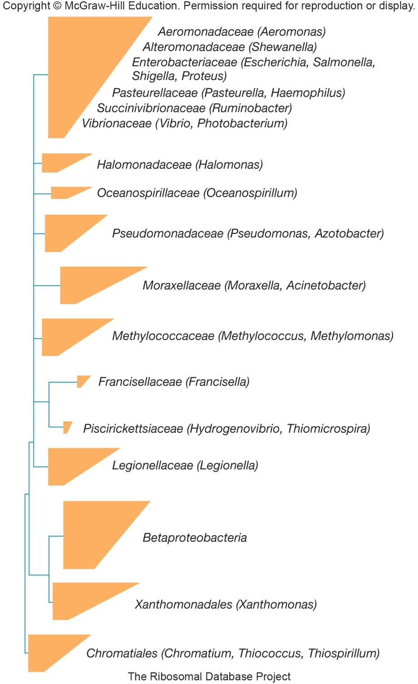
Class Gammaproteobacteria
Largest subgroup of proteobacteria
contains 14 orders and 28 families
Very diverse physiological types
chemoorganotrophs, photolithotrophs, chemolithotrophs, methylotrophs
aerobic and anaerobic
Many deeply branching groups

Slide 46
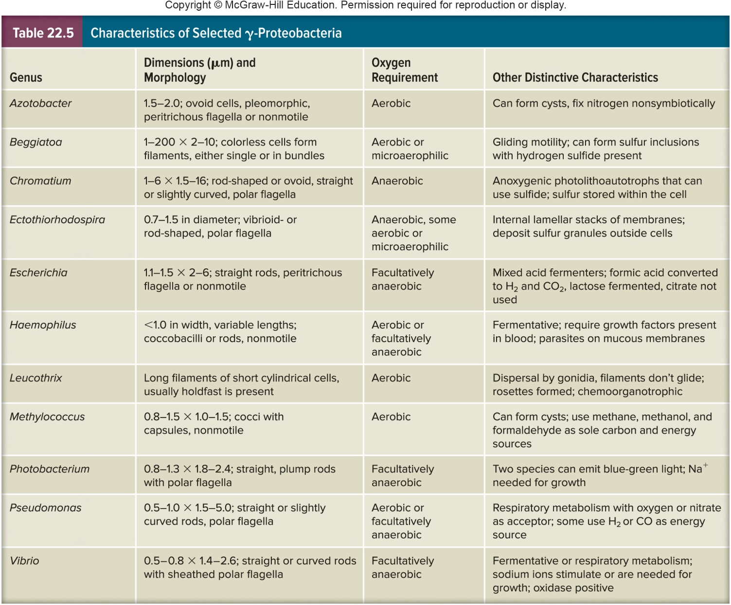
Characteristics of Select Gammaproteobacteria

Slide 47
The Purple Sulfur Bacteria
Placed in order Chromatiales
divided into two families, Chromatiaceae and Ectothiorhodospiraceae
Family Ectothiorhodospiraceae composed of red, spiral-shaped, polarly flagellated cells that deposit sulfur globules externally

Slide 48
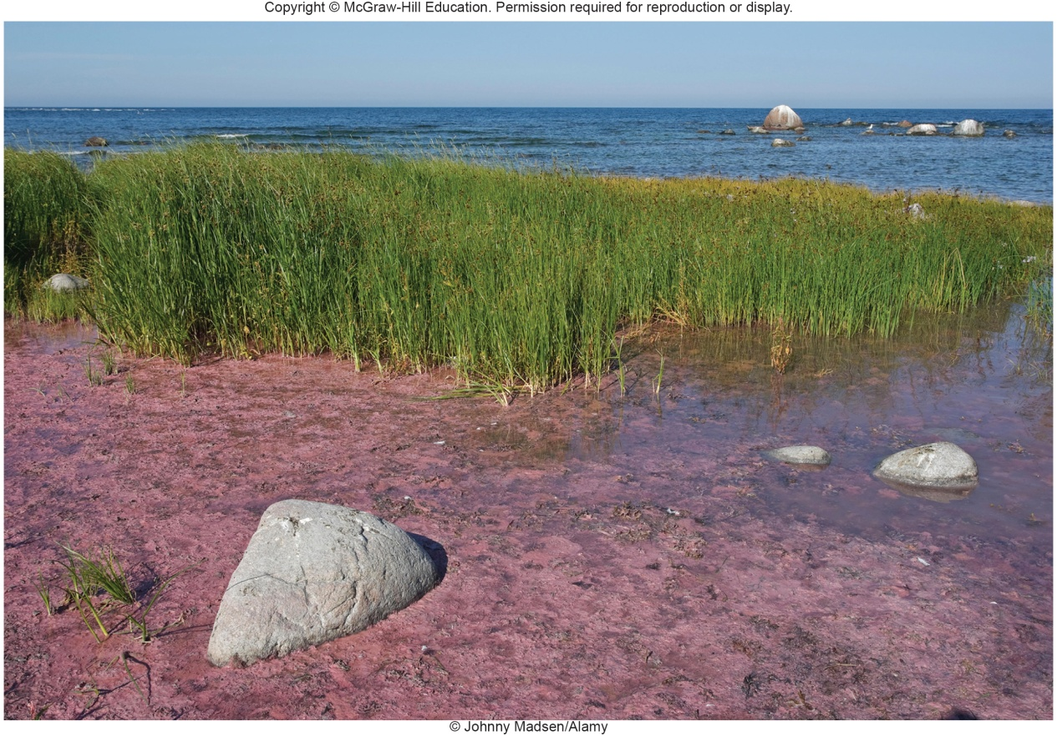
Family Chromatiaceae
Strict anaerobes
Usually photoautolithotrophs
use H₂S as electron donor
deposit sulfur granules internally
often eventually oxidize sulfur to sulfate
may also use hydrogen as electron donor
Usually found in anaerobic, sulfide-rich zones of lakes
can cause large blooms in bogs and lagoons

Slide 49
Order Thiotrichales
Contains three families
largest is Thiotrichaceae
contains several genera of that oxidize sulfur
rods and filamentous forms
best studied genera are Beggiatoa, Leucothrix, and Thiothrix

Slide 50
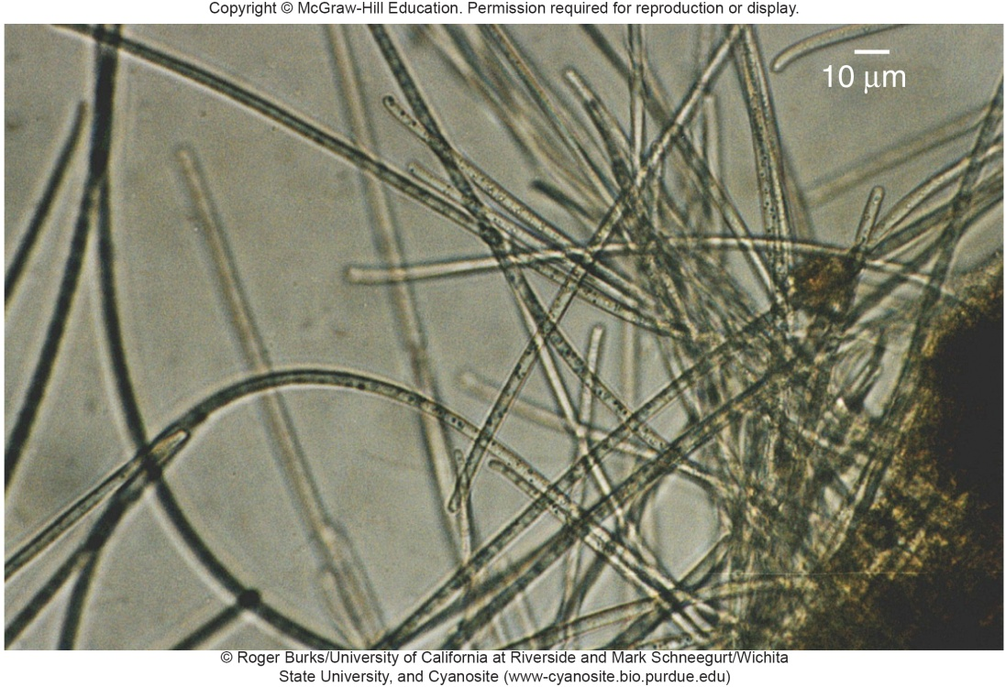
Genus Beggiatoa
Filaments lack sheath
Metabolically versatile
can oxidize H₂S to sulfur
deposited internally in pockets formed by invaginations of plasma membrane
can grow heterotrophically with acetate as a carbon source
some may incorporate CO₂ autotrophically
grow in sulfide-rich habitats

Slide 51
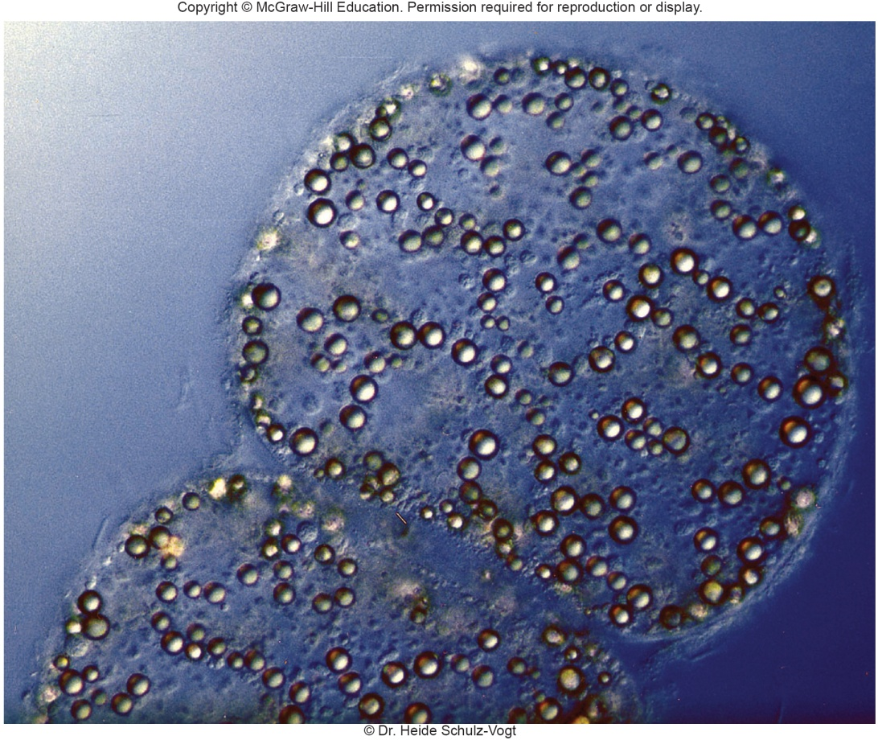
Genus Thiomargarita
Among largest bacteria
Over 100 microns in diameter and hundreds of centimeters long
Beggiatoa, Thioploca, Thiomargarita grow in bundles, appear hollow

Slide 52
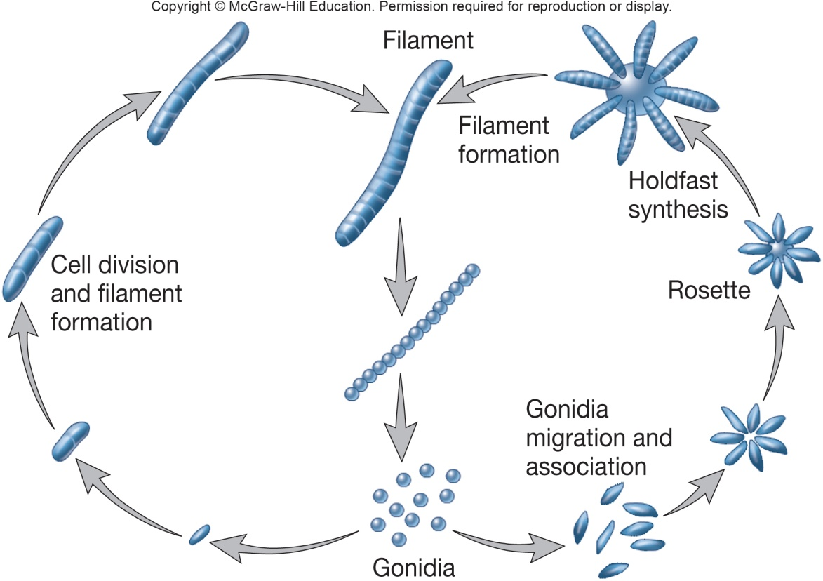
Genus Leucothrix
Aerobic chemoorganotrophs
Forms filaments or trichomes up to 400 microns long
Marine, complex lifestyle in which dispersal is by formation of gonidia

Slide 53
Genus Thiothrix
Related to Leucothrix with gonidia
Chemolithotrophic
oxidize hydrogen sulfide
deposit sulfur granules internally
mixotrophic
use inorganic energy source and organic carbon source
Found in sulfide-rich flowing water and activated sludge sewage systems

Slide 54
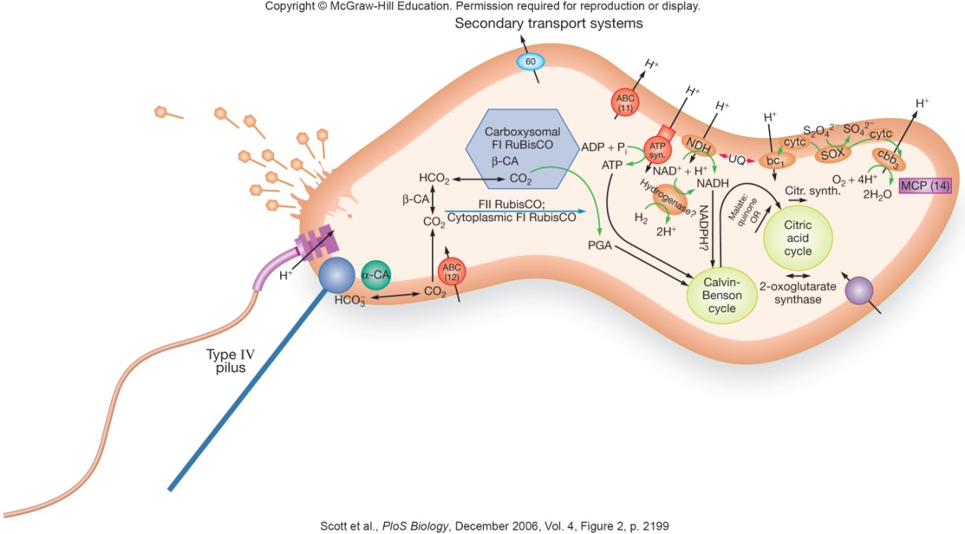
Genus Thiomicrospira
Polyphyletic – γ- Ɛ-proteobacteria
Unique environment
hydrothermal vent deep sea microbe
can utilize differences in dissolved CO₂
multienzyme complex (SOX) for sulfur oxidation
aerobic – oxygen is electron acceptor
prophage in chromosome

Slide 55
Order Methylococcales
Contains family Methylococcaceae; seven genera
Morphologically diverse
e.g. genus Methylococcus – spherical, nonmotile
e.g. genus Methylomonas – straight, curved, or branched rods with single polar flagella
almost all form resting stage (cystlike structure)
Methylotrophs
use reduced one-carbon compounds as sole carbon and energy source

Slide 56
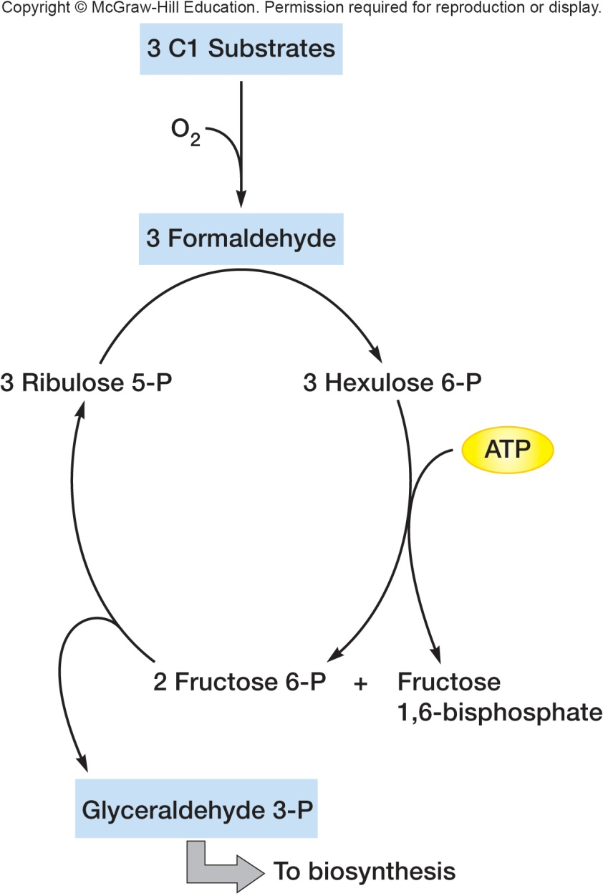
Methane Oxidation
Occurs in complex arrays of intracellular membranes
Oxidized to methanol and then to formaldehyde
electrons donated to electron transport chain for ATP synthesis
formaldehyde can be assimilated into cell material

Slide 57
Order Legionellaceae
Family Legionellacaea
genus Legionella
Family Coxiellaceae
genera Coxiella and Rickettsiella
All are intracellular pathogens
dimorphic lifestyle (two forms)

Slide 58
Genus Legionella
L. pneumophilia intensely studied
causative agent Legionnaire’s disease
transmission through aerosols
intracellular pathogen of protozoa
invade cooling towers, air conditioning, hot tubs
Gram-negative rods that replicates by binary fission
life cycle in a protist
replicative forms (RFs) reside in host vacuole (replicative endosome)
RFs differentiate into mature intracellular forms (MIFs) which are the infectious form
MIF are metabolically dormant, heat tolerant, and resistant to antibiotics
Hsp60 is invasin used to invade host cell

Slide 59
Genus Coxiella
Host range
birds, insects, fish, rodents, sheep, goats, humans
Transmitted through aerosol
Life cycle similar to L. pneumophilia
small cell variant (SCV) enters cell by phagocytosis
phagosome low pH triggers SCV to become metabolically active
SCV differentiates into large cell variant (LCV)
replicates by binary fission, are infectious
long-term survival outside the host

Slide 60
Order Pseudomonadales
Contains family Pseudomonadaceae
Pseudomonas is the most important genus in the order Pseudomonadales
heterogenous - 60 species
Gram-negative straight or slightly curved rods
0.5 to 1.0 μm by 1.5 to 5.0 μm in length
motile by one or several polar flagella
lack prosthecae or sheaths

Slide 61
Pseudomonas
Chemoheterotrophs with respiratory metabolism
usually use oxygen as electron acceptor
sometimes use nitrate as electron acceptor
have functional TCA cycle
most hexoses are degraded by Entner-Duodoroff pathway
Practical importance of pseudomonads
degrade wide variety of organic molecules
mineralization - microbial breakdown of organic materials to inorganic substrates
important experimental subjects
some are major animal and plant pathogens
some cause spoilage of refrigerated food
can grow at 4°C

Slide 62
Genus Azotobacter
Often pleomorphic, motile rods
Aerobic, catalase positive
Chemoorganotrophs
Widespread in soil and water

Slide 63
Order Alteromonadales
Genus Altermonas
strictly aerobic, nonspore-forming, straight or curved rods, motile with single polar flagella
mesophilic, require sodium ions for growth

Slide 64
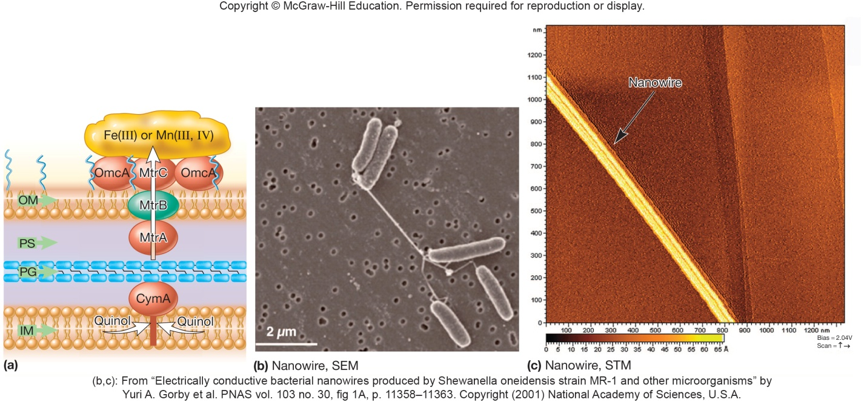
Genus Shewanella
Found in seawater, lake sediments, salted foods
Facultatively anaerobic with diverse electron acceptors used (uranium, chromium, neptunium, plutonium, vanadate)
excellent candidate for bioremediation
Dissimilatory metal reduction
no assimilation of metals
evolved strategies for use of insoluble metals (Fe(III) or Mn(IV)) as electron acceptors
localize cytochromes in outer membrane
electron shuttles transfer electrons to mineral surface

Slide 65
Order Vibrionales
Contains one family, Vibrionaceae
Most are aquatic, most free-living
straight or curved rods, oxidase positive, flagellated
some important pathogens
some symbiotic in luminous organs of fish
Closely related to two other orders
Enterobacteriales and Pasteurellales
Vibrio cholerae is an important pathogen
pathogen that causes cholera
genome has been sequenced
has two circular chromosomes
copies of some genes present on both chromosomes
cholera toxin gene is integrated phage on chromosome 1

Slide 66
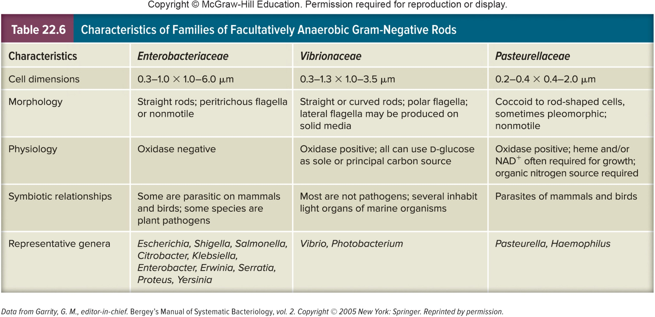
Characteristics of Facultative Anaerobic Gram-Negative Rods

Slide 67
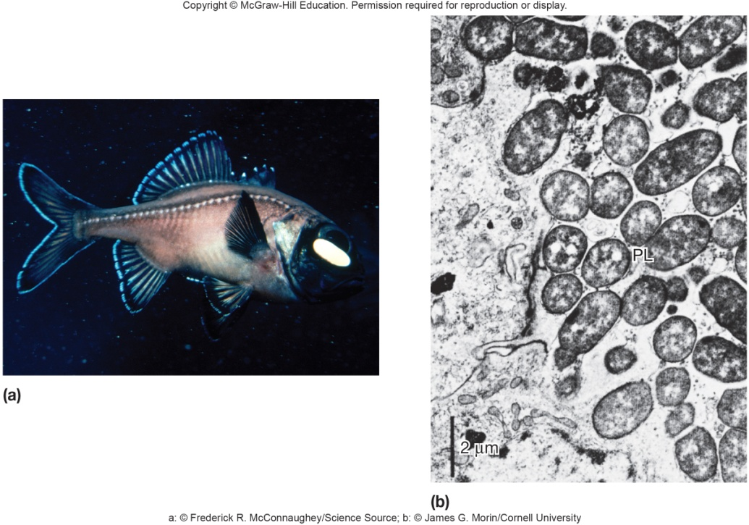
V. fischeri, V. harveyi
Free-living
Capable of bioluminescence
emission of light catalyzed by luciferase
symbiotic relationship with fish organs
also observed in at least two species of Photobacterium

Slide 68
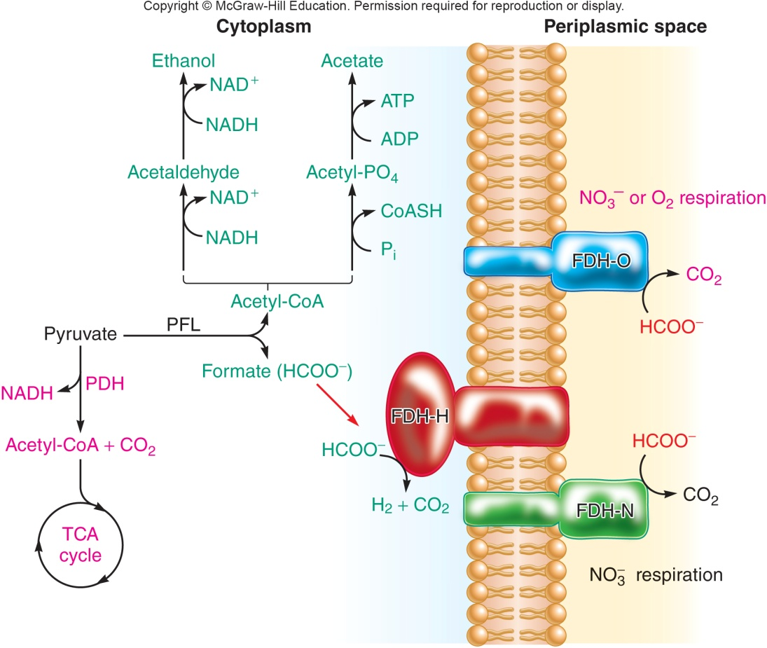
Order Enterobacteriales
One family, Enterobacteriaceae; 44 genera
enteric bacteria or enterobacteria
Facultative anaerobes
Chemoorganotrophs degrade sugars by glycolytic pathway
cleave pyruvate to yield formic acid

Slide 69
Family Enterobacteriaceae
Two groups based on fermentation products
majority are mixed acid fermenters
produce lactate, acetate, succinate, formate, and ethanol
others are butanediol fermenters
butanediol, ethanol, and carbon dioxide
Biochemical tests used to distinguish genera in addition to morphology, motility, growth responses
Very common, widespread, and important

Slide 70
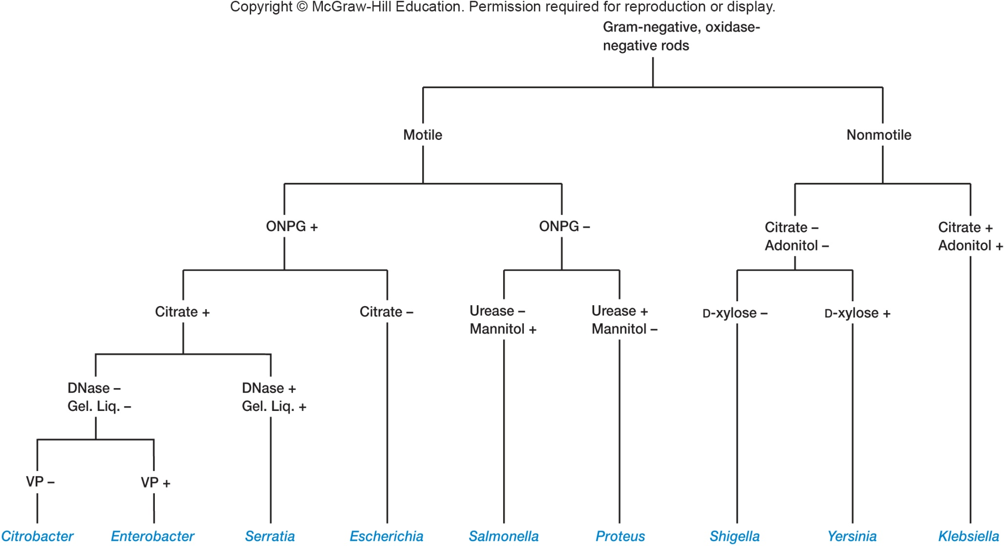
Identification of Enterobacterial Genera

Slide 71
Escherichia coli
Probably best studied bacterium
Inhabitant of intestinal tracts of many animals
Used as indicator organisms for testing water for fecal contamination
Some strains are pathogenic
gastroenteritis
urinary tract infections

Slide 72
Important Pathogenic Enteric Bacteria
Salmonella – typhoid fever and gastroenteritis
Shigella – bacillary dysentery
Klebsiella – pneumonia
Yersinia – plague
Erwinia – blights, wilts, etc., of crop plants

Slide 73
Order Pasteurellales
One family, Pasteurellaceae
Small, nonmotile, oxidase positive
Important pathogens
Pasteurella multocida – fowl cholera
Pasteurella haemolytica – pneumonia in cattle, sheep, and goats
Haemophilus influenzae – variety of diseases, including meningitis in children; vaccine available

Slide 74
22.4 Class Deltaproteobacteria Includes Chemoheterotrophic Anaerobes and Predators - 1
Characterize the common physiological features of sulfate-reducing bacteria (SRB)
Identify common carbon substrates used by SRB
Draw an electron transport chain capable of dissimilatory sulfate reduction
Relate the physiology of SRB to their common environmental niches

Slide 75
22.4 Class Deltaproteobacteria Includes Chemoheterotrophic Anaerobes and Predators - 2
List the physiological and ecological similarities between Shewanella and Geobacter spp.
Draw the life cycle of a bdellovibrio and explain why it is considered a bacterial predator
Relate the life cycle of myxobacteria to their habitat and means of acquiring nutrients
Describe the two types of gliding motility displayed by myxobacteria, and sketch their respective mechanistic models

Slide 76
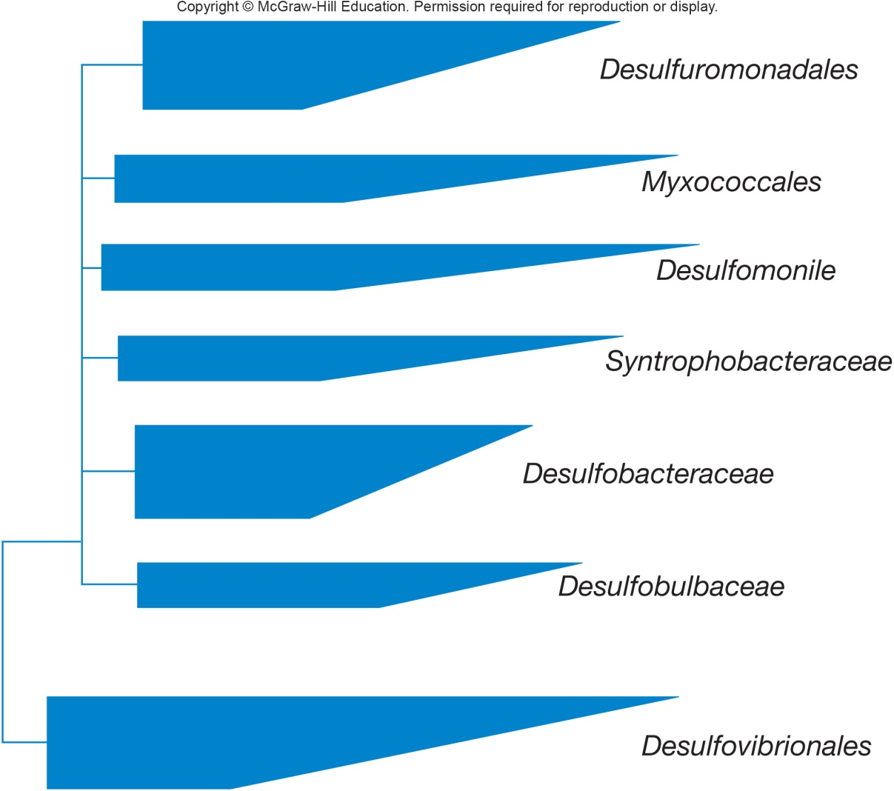
Class Deltaproteobacteria
Contains eight orders and 20 families
divided into two general groups
aerobic, chemoorganotrophic predators
anaerobic, chemoorganotrophic sulfur- and sulfate-reducers

Slide 77
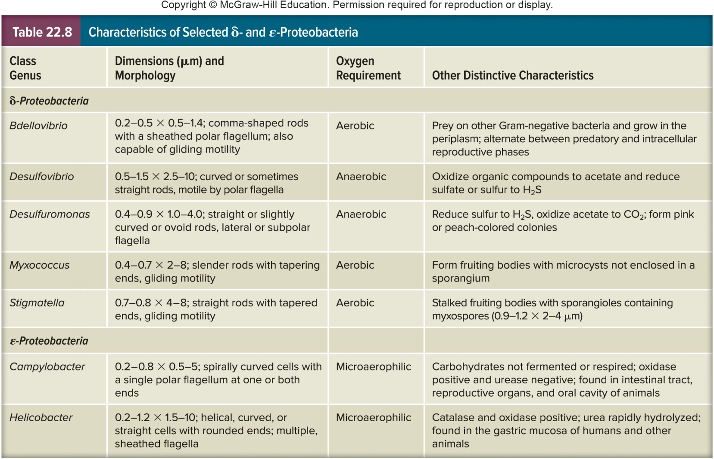
Characteristics of Select Delta- and Epsilonproteobacteria

Slide 78
Orders Desulfovibrionales, Desulfobacterales, and Desulfuromonadales
Strict anaerobes
Sulfur- or sulfate-reducing bacteria
use sulfur and sulfate as electron acceptors during anaerobic respiration
electron transport chain used to generate ATP
Widespread in muds and sediments of aquatic environments, including sewage treatment systems
important in sulfur cycling in ecosystems

Slide 79
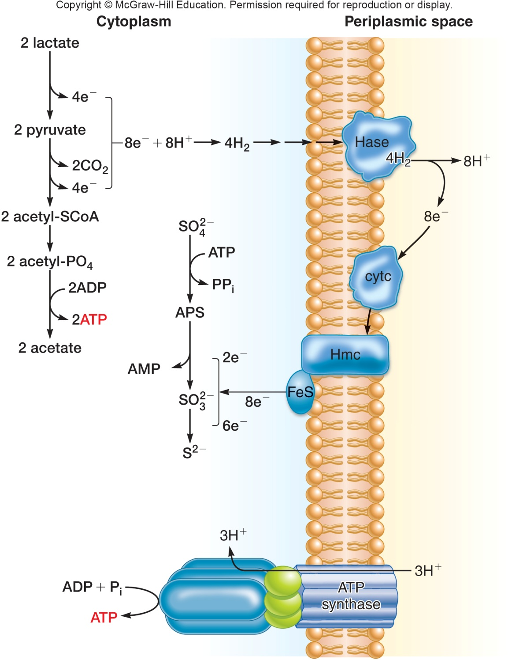
Desulfovibrio Dissimilatory Sulfate Reduction

Slide 80
Order Desulfuromonales
All strictly anaerobic with respiratory or fermentative metabolism
chemolithotrophs, chemoorganotrophs
mesophilic, marine, and fresh water
Environmentally important
conserve energy from dissimilatory metal reduction including toxic and radioactive metals
synthesize nanowires
electricity generated by microbial fuel cells

Slide 81
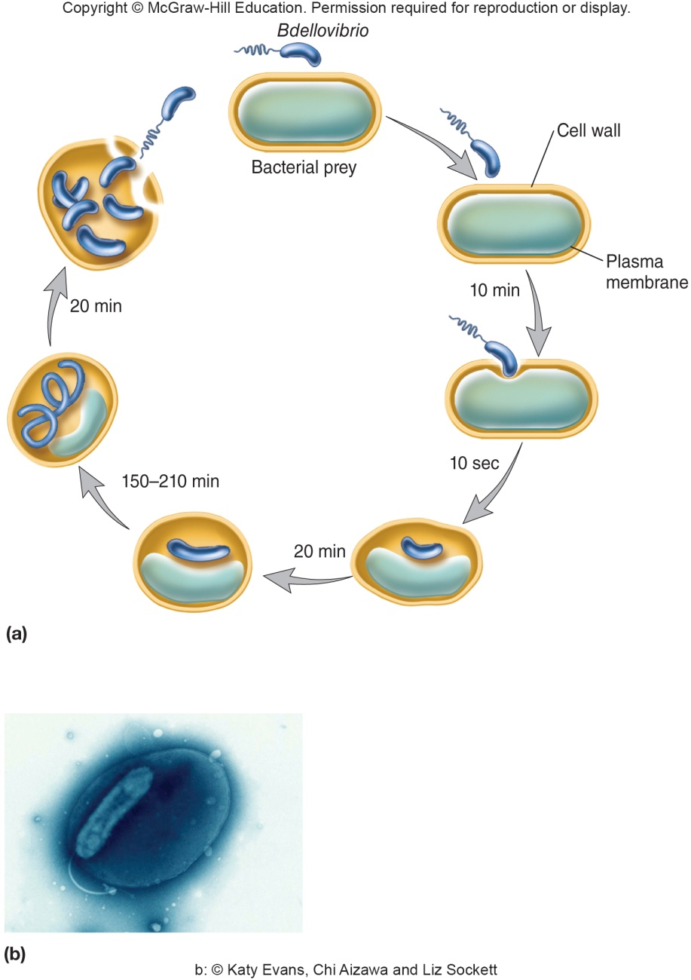
Order Bdellovibrionales
One family, Bdellovibrionaceae; four genera
best studied is Bdellovibrio
aerobic, Gram-negative, motile curved rods
predatory bacteria life cycle that resembles bacteriophages in many ways

Slide 82
Order Myxococcales
Contains six families distinguished based on shape of vegetative cells, myxospores, and sporangia
Gram-negative, rod-shaped gliding bacteria
Aerobic chemoorganotrophs with respiratory metabolism
most are micropredators or scavengers that lyse bacteria and yeasts by secretion of digestive enzymes
most use amino acids as major source of C, N, and energy

Slide 83
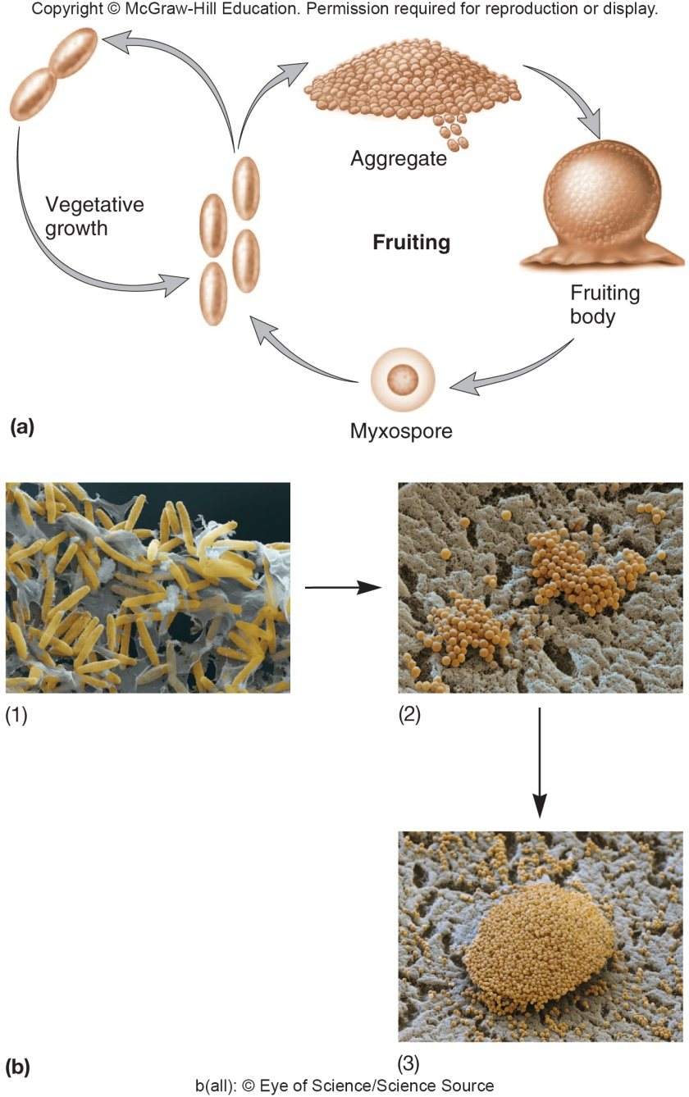
Myxobacteria
Distinctive life cycle which resembles that of cellular slime molds
In presence of food form a swarm and migrate on solid surfaces
Form a fruiting body when nutrients are exhausted
involves at least 5 extracellular signaling molecules which allow cells to communicate with each other

Slide 84
Fruiting Bodies
Formation requires gliding motility and involves at least 5 extracellular signaling molecules which allow cells to communicate with each other
Range in height from 50 to 500 μm
Colored by carotenoid pigments
Vary in complexity
Some cells develop into myxospores
frequently enclosed in walled structures called sporangioles (sporangia)
dormant and desiccation-resistant
may survive up to 10 years

Slide 85
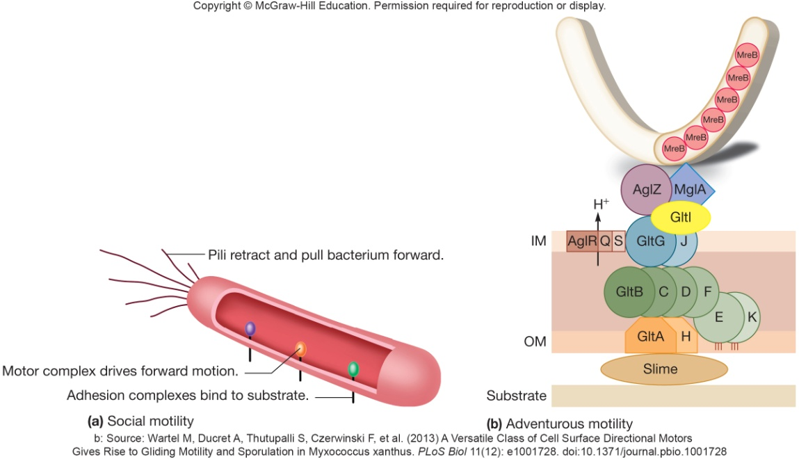
M. xanthus Gliding Motility
Social (S) motility – twitching motility
governed by production of retractable type IV pili
when pili retract, cell creeps forward
requires cell to cell contact for pili
Adventurous (A) motility
single cells that leave the group
involved in slime secretion and clusters of motor proteins in contact with substrate

Slide 86
22.5 Class Epsilonproteobacteria Ranges from Pathogens to Deep-Sea Bacteria
List two common human illnesses caused by the ε-proteobacteria
Describe the unusual metabolism of Helicobacter spp. and explain how H. pylori can tolerate the acidic conditions within the stomach
Describe some of the unusual habitats that recently discovered ε-proteobacteria inhabit

Slide 87
Class Epsilonproteobacteria
Smallest of proteobacterial classes
Probably two orders, Campylobacteriales and Nautiliales; three families
Slender Gram-negative rods

Slide 88
Genus Campylobacter
Campylobacter fetus
reproductive disease and abortions in cattle and sheep
septicemia and enteritis in humans
septicemia – pathogens or their toxins in blood
enteritis – inflammation of intestinal tract
Guillain-Barre syndrome triggered in molecular mimicry
Campylobacter jejuni
abortions in sheep
enteritis diarrhea in humans

Slide 89
Genus Helicobacter
At least 23 species isolated from stomachs and upper intestines of mammals
e.g. Helicobacter pylori
causes gastritis and peptic ulcer disease
motility important for colonization
does not grow below pH 4.5
urease converts urea to ammonia and CO₂
urea hydrolysis appears to be associated with virulence

Slide 90
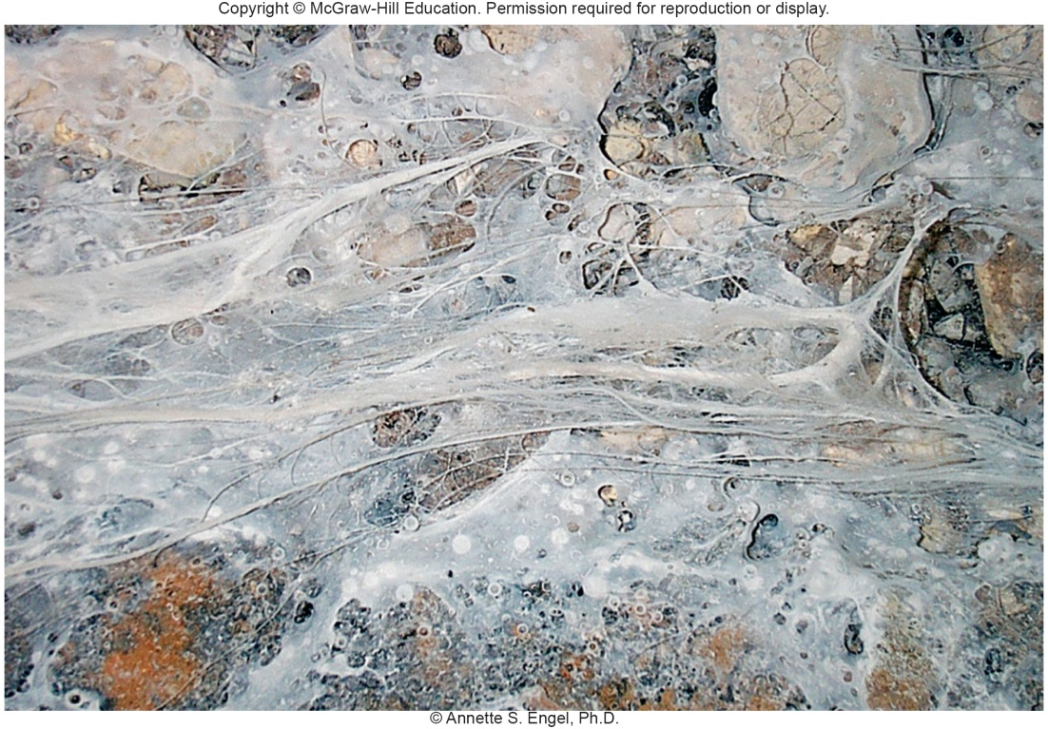
Epsilonproteobacteria
Newly discovered; are
thermophilic, chemo-
lithoautotrophic, and
others
Found in marine hydrothermal vents, terrestrial springs, ground water, oil-field brines, limestone caves, sulphidic springs
Found in filamentous microbial mats in anoxic, sulfide-rich cave springs

Slide 91
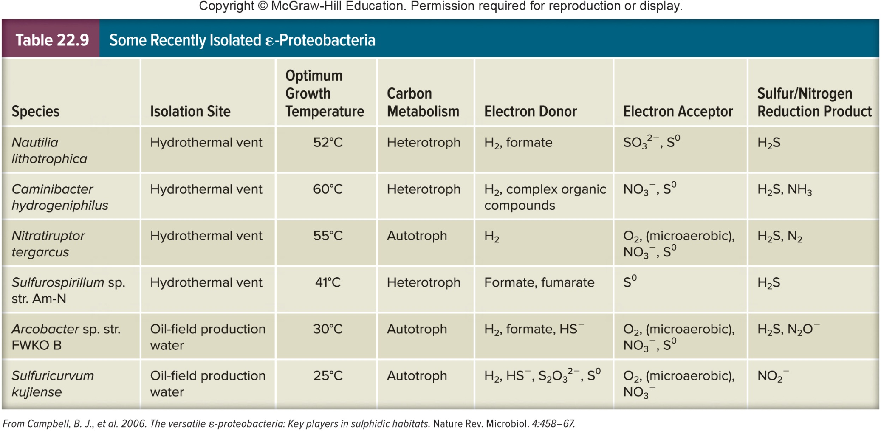
Recently Isolated Epsilonbacteria

Slide 92
Take Home Message
Taxonomy of the proteobacteria is an immense and ever-changing subject
As you examine each group of microbes, try to distill the content down into similarities and differences between them
The goal here is not to make you an expert bacterial taxonomist – the goal is to give you a basic understanding of what exists where, and how it exists there

